Slide 1
Lessons from the
Spectrum of Physician Advocacy-1 (SPA-1) Free Time Elective
Katelyn Carey BUSM ‘17 Molly Zielenbach BUSM ‘16 MD MPH
Karen Foo BUSM ‘17 Johnna Murphy MPH
Genevieve Guyol BUSM ‘17 Megan Sandel MD MPH
Jawad Husain BUSM ‘17
Janine Petito BUSM ‘17
Notes:
2 min intro
1-2 min for class + study design (class has not been evaluated objectively)
2 mins results
1 min reflections
3 mins discussion + next steps

Slide 2
Introduction
BMC aims to provide “exceptional care, without exception” to a 59% underserved population¹
BU Advocacy Training Program (buATP) started 10 years ago to train BUSM students to:
Understand the the social determinants of health on a theoretical level
Intervene directly to address the social issues disrupting a patient’s health at the individual or community levels
Many organizations have called for incorporating advocacy as part of the core competency of professionalism in medical training²
This study sought to evaluate the effectiveness of our Spectrum of Physician Advocacy (SPA-1) elective and measure students’ attitudes, knowledge, and confidence around health advocacy
Notes:
Jawad presents introduction in 2 minutes
Notes from run-through: 2:22
Mentored by Dean Witzburg and Megan Sandel
Medical and dental students
?necessity of mentioning other aspects of buATP
Excellent mention of lack of standardized competencies
Change order of bullet points 2←>3 if that is the order it will be spoken in?

Slide 3
Student-Led, Faculty-Mentored SPA -1 Elective
7 Didactic Sessions
Intro to Advocacy/Public Health
Street Violence
Addiction & Harm Reduction
Correctional Health
Early Childhood Care
Immigrant/Refugee Health
Health Insurance/Policy Reform
Advocacy Project
Community-based activity Presentation at final potluck
Didactic Session Format
Introduction of Content Expert Speaker Group Discussion/Activity
Notes:
First formalized curriculum for teaching advocacy; didactics + project
= Intervention
Session topics derived from student interest (some modifications every year based on current leadership)
Physician/expert speaker is invited both as a form of information quality control and to serve as role models for future physician advocates
To tie the course together and encourage students to get hands on experience, we invite them to apply concepts from the class and engage in topics we’ve discussed in a final advocacy project, which they complete in the community and present to the class during our final session
Notes from run-through: 3:45
These are the topics that we covered last year during the study
Didactic sessions first then advocacy project
Need to clarify that this is our intervention

Slide 4
Study Design
Survey Design:
Demographics
Four main advocacy categories:
Self-reported advocacy attitudes
Self-reported advocacy knowledge
Objective advocacy knowledge
Confidence in advocacy skills
Analyses:
Pre- vs. post-intervention: Paired t-tests
Pre-intervention vs. control group: Fisher’s exact or chi-square
Study Group:
24 first-year medical and dental students enrolled in SPA-1 elective
Control Group:
32 first-year medical students not enrolled in SPA-1
Survey Administration:
Study Group: Beginning and end of SPA-1
Control Group: Single administration
Notes:
Explain categories of measures
Surveys were administered to 24 students enrolled in SPA-1 before and after completing the course, as well as a control group of 32 first-year medical students not enrolled in SPA-1
Categories:
1-3 assessed with Likert scale, 4 fill-in-the-blank questions
Self-reported advocacy attitudes
Ex. Role of healthcare professional in advocacy/physicians’ responsibility to address social determinants of health
Ex. Role of advocacy education in medical school curriculum
Self-reported advocacy knowledge
Ex. Recognition of how social determinants of health impact patients
Confidence in advocacy skills
Ex. Confidence in ability to elicit history and empathize with a patient’s social situation
Objective advocacy knowledge
Ex. Identifying resources for patients
Pre- and post-intervention data were analyzed using paired t-tests.
Pre-intervention and control groups were compared using Fisher’s exact or chi-square tests.
Notes from Run-Through: (4:48)
-need to clarify likert scale

Slide 5
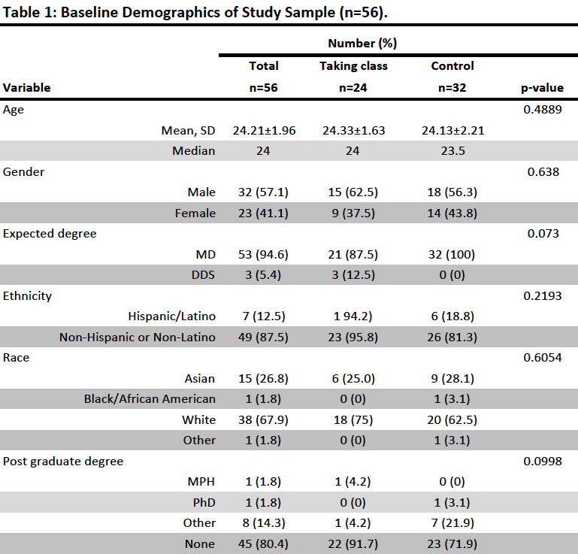
Results:
Demographics
Notes:
Notes from run-through
5:11

Slide 6
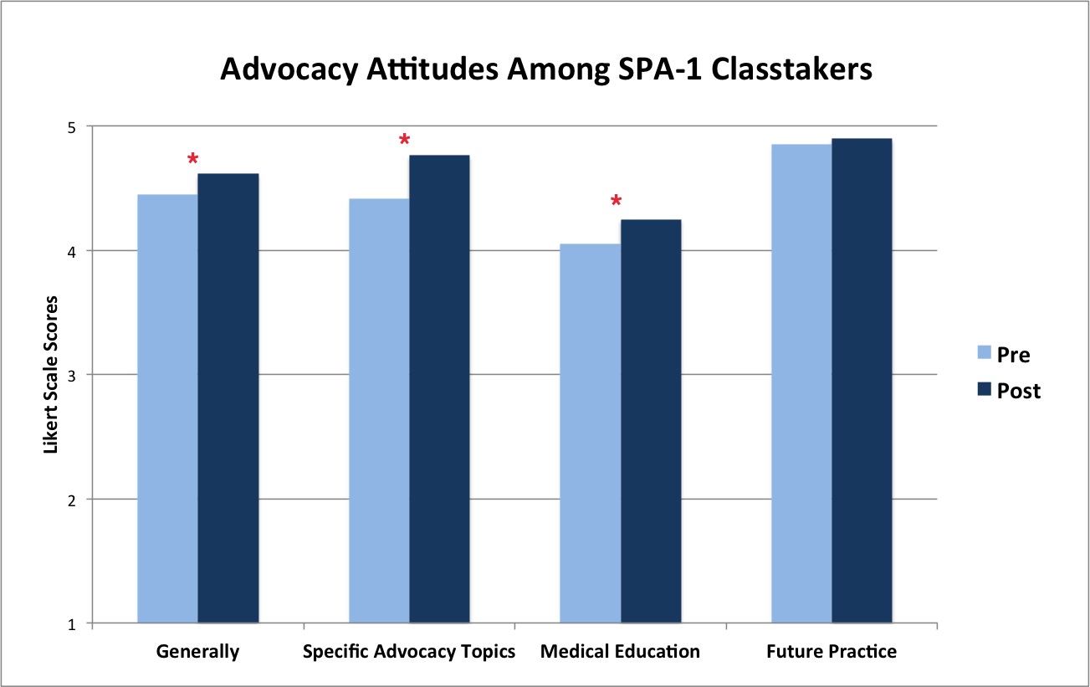
Results:
Pre- vs. Post-
Intervention
Attitudes
Notes:
7:36

Slide 7
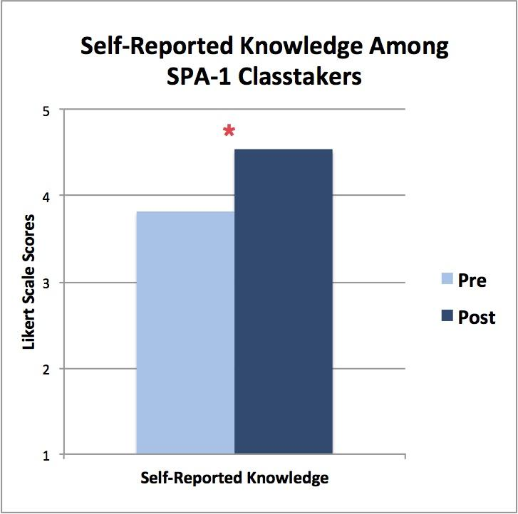
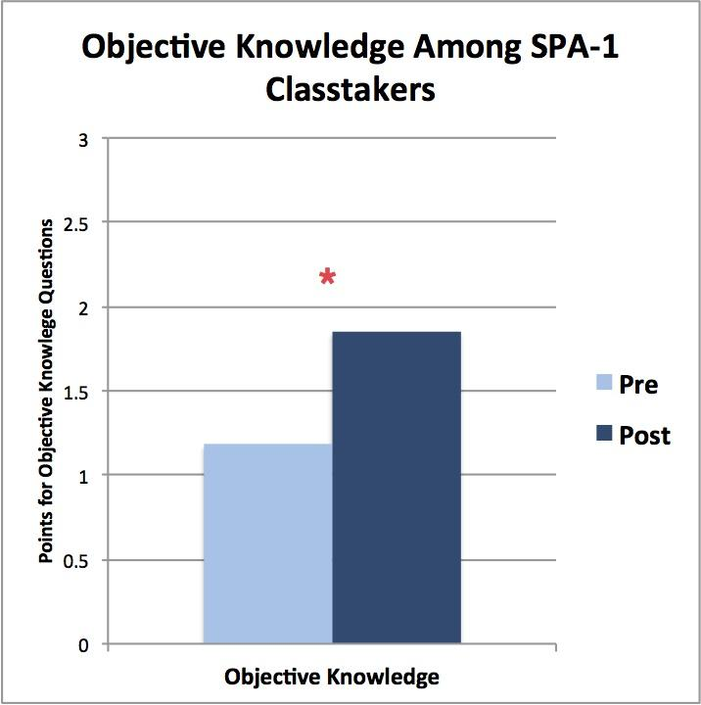
Results:
Pre- vs. Post-intervention Knowledge
Notes:
7:59

Slide 8
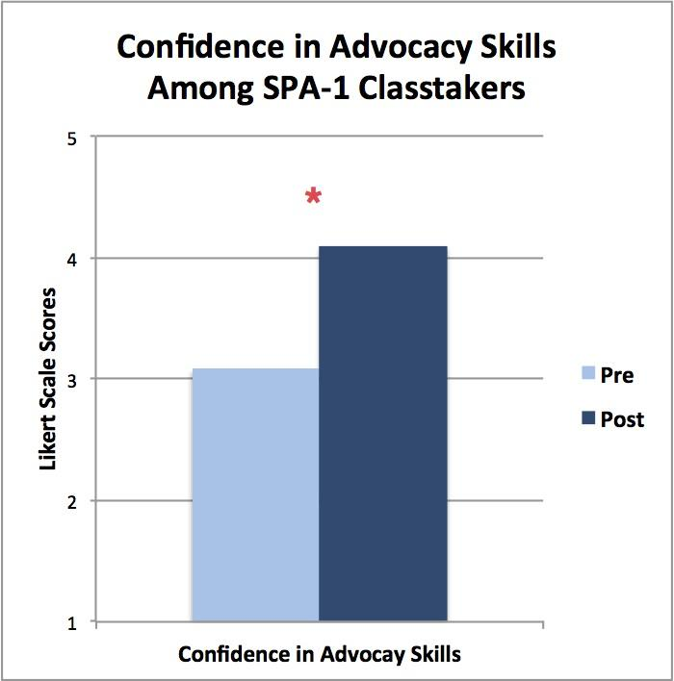
Results:
Pre- vs. Post-
Intervention
Confidence

Slide 9
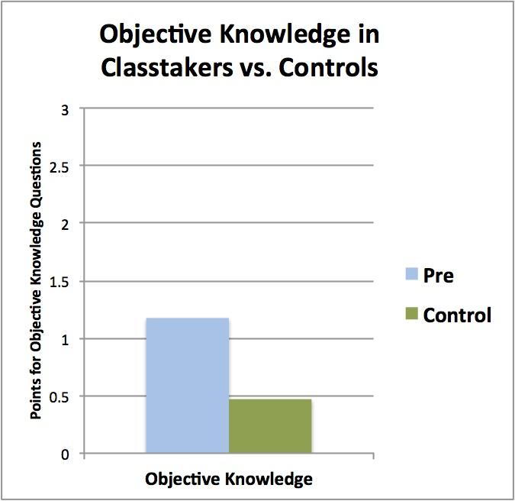
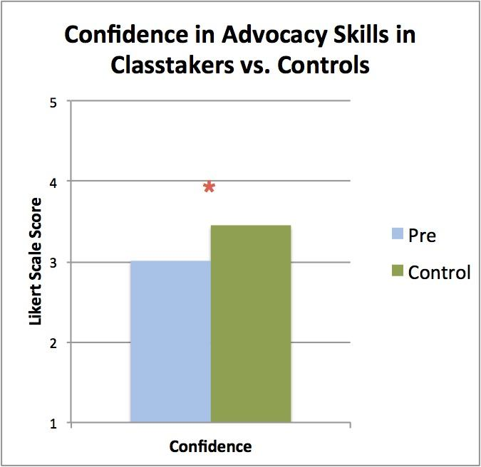
Results: Pre-intervention vs. Controls
Notes:
Attitudes in Classtakers vs. Controls
General - no significant difference (p=0.9606)
Specific Topics - did not do analysis yet
Medical Education - *significant difference (p=0.0047)
Future Practice - *significant difference (p=0.0002)
6:19

Slide 10
Discussion
Improvement in attitudes, knowledge, and skills indicates that a student-led, faculty-mentored program is an effective method of advocacy education at BUSM
Similar baseline objective knowledge, but difference in confidence, in pre-intervention compared to control suggests that all students could benefit from this curriculum
Limitations: small sample size, single institution, single time point controls
Notes:
Student-led, faculty-mentored is effective teaching model
-origin of this program is students seeking to fill a void in their education that is missing
-this model allows for selection of topics that are relevant and interesting to students (eg. recent student interest and involvement in addiction here in Massachusetts)
-empowers students as advocates as they are actively engaged in a community of practice
Similar objective knowledge but increased confidence among control group
-greater confidence may be explanation for not taking class but we have evidence that knowledge scores were similar
-given that advocacy is a component of professional responsibility and relevance of these topics to our patient population here at BMC, this curriculum could benefit all students → opportunity to design advocacy competencies to be met by all BUSM graduates
Limitations: small sample size, single institution, single time point controls (could improvement have happened due to other factors?)
10:37

Slide 11
Next Steps
Investigate strategies to incorporate advocacy education into the BUSM core curriculum, while maintaining a learner-centered model
Characterize and address interests of BUSM students not currently engaged in advocacy programming

Slide 12
Reflections on a Student-Led, Faculty-Mentored Advocacy Elective
The BU Advocacy Training Program provides:
An opportunity to learn about social issues that shape our patients’ lives
Mentorship from experienced physician advocates
A community of humanistic, socially conscious medical and dental students
Valuable experience in leadership and teaching
Notes:
Jawad presents personal reflections in 1 min

Slide 13
Special Thanks To:
Lauren Fiechtner MD MPH Chen Kenyon MD MSHP
Bob Witzburg MD Suzanne Sarfaty MD
Daniel Dworkis MD PhD Michelle Sia DO
Jessie Gaeta MD Michael Siegel MD
Ana Gregory Ed.M. Anita Knopov (BUSM ‘18)

Slide 14
References
“About BMC.” Boston Medical Center. N.p., n.d. Web. 25 May 2016. <http://www.bmc.org/about.htm>
Croft D, Jay SJ, Meslin EM, Gaffney MM, Odell JD. Perspective: Is It Time for Advocacy Training in Medical Education? Acad Med. 2012;87(9):1165–1170. doi:10.1097/ACM.0b013e31826232bc.
Belkowitz J, Sanders LM, Zhang C, et al. Teaching Health Advocacy to Medical Students: A Comparison Study. J Public Health Manag Pract. 2013;33431(00):1–10. doi:10.1097/PHH.0000000000000031.
Bhate TD, Loh LC. Building a Generation of Physician Advocates. Acad Med. 2015;90(12):1. doi:10.1097/ACM.0000000000000841.
Dharamsi S, Ho A, Spadafora SM, Woollard R. The physician as health advocate: translating the quest for social responsibility into medical education and practice. Acad Med. 2011;86(9):1108–13. doi:10.1097/ACM.0b013e318226b43b.
Dworkis DA, WIlbur MB, Sandel MT. A Framework for Designing Training in Medical Advocacy. Acad Med. 2010;85(10):1549–1550. doi:10.1016/0002-9610(92)90118-B.

Slide 15
Supplementary Slides

Slide 16
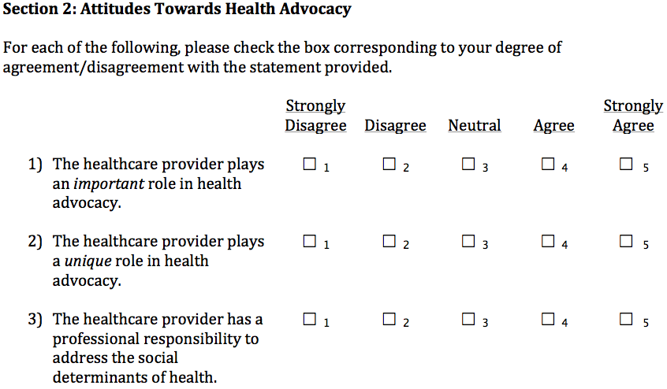
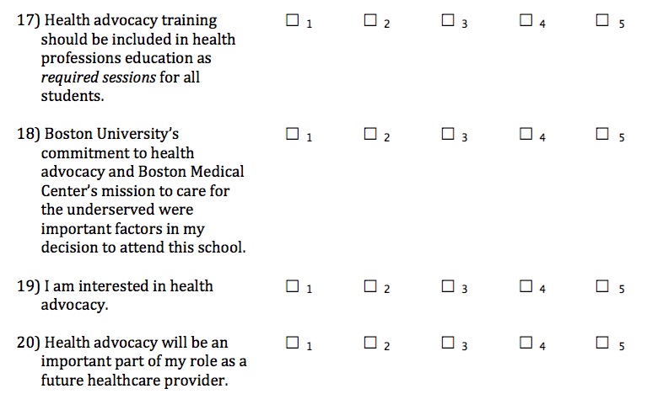
Self-Reported Advocacy Attitudes

Slide 17
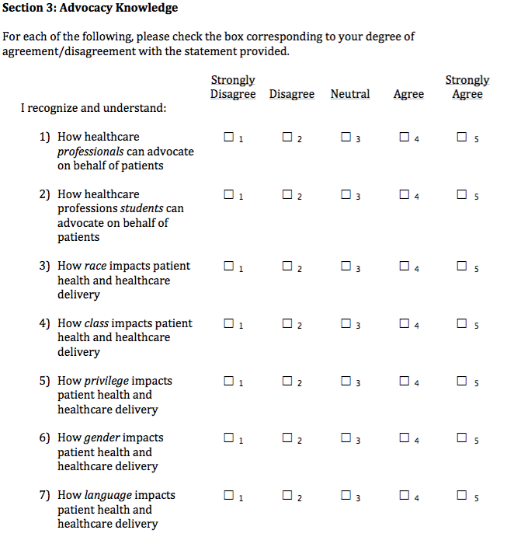
Self-Reported Advocacy Knowledge

Slide 18
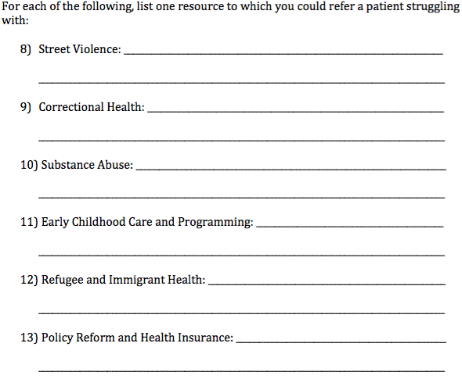
Objective Advocacy Knowledge

Slide 19
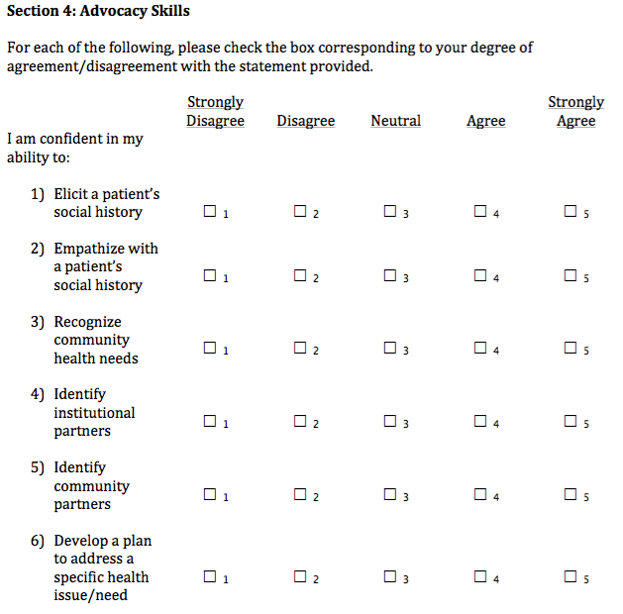
Confidence in Advocacy Skills

