Slide 1

The US Health Care System,
Recent Reforms
Randall P. Ellis, Ph.D.
Department of Economics
Boston University
April 3, 2017

Slide 2
Why listen to an American professor talk about health care and innovation?
US has a terrible health care system
Horribly expensive, unfair, low quality
I have no particular experience writing about on innovation
BUT
US has lots of innovations and good data
US tends to drive health systems worldwide
I am
  professor
  active scholar on US and international events
  Board member of the Hospinnomics in Paris
  former president of the American Society of Health Economists
  former president of a start-up health IT company, DxCG
  Someone who follows health markets and politics closely
New, broad perspective

Slide 3
Affordable Care Act (= ObamaCare) Left Intact the Existing Complex System
Many diverse insurers % of people, 2010
Employment-based insurance 55.3%
Medicare (elderly and disabled) 14.5%
Medicaid/children (poor/children/high cost) 15.9%
Military insurance 4.2%
Direct insurance purchase (individual) 9.8%
Uninsured 16.3%
Note: numbers sum to more than 100% since many people have multiple coverage.
Source: http://www.census.gov/hhes/www/hlthins/data/incpovhlth/2010/table10.pdf
Biggest effect of ACA is on these two groups

Slide 4
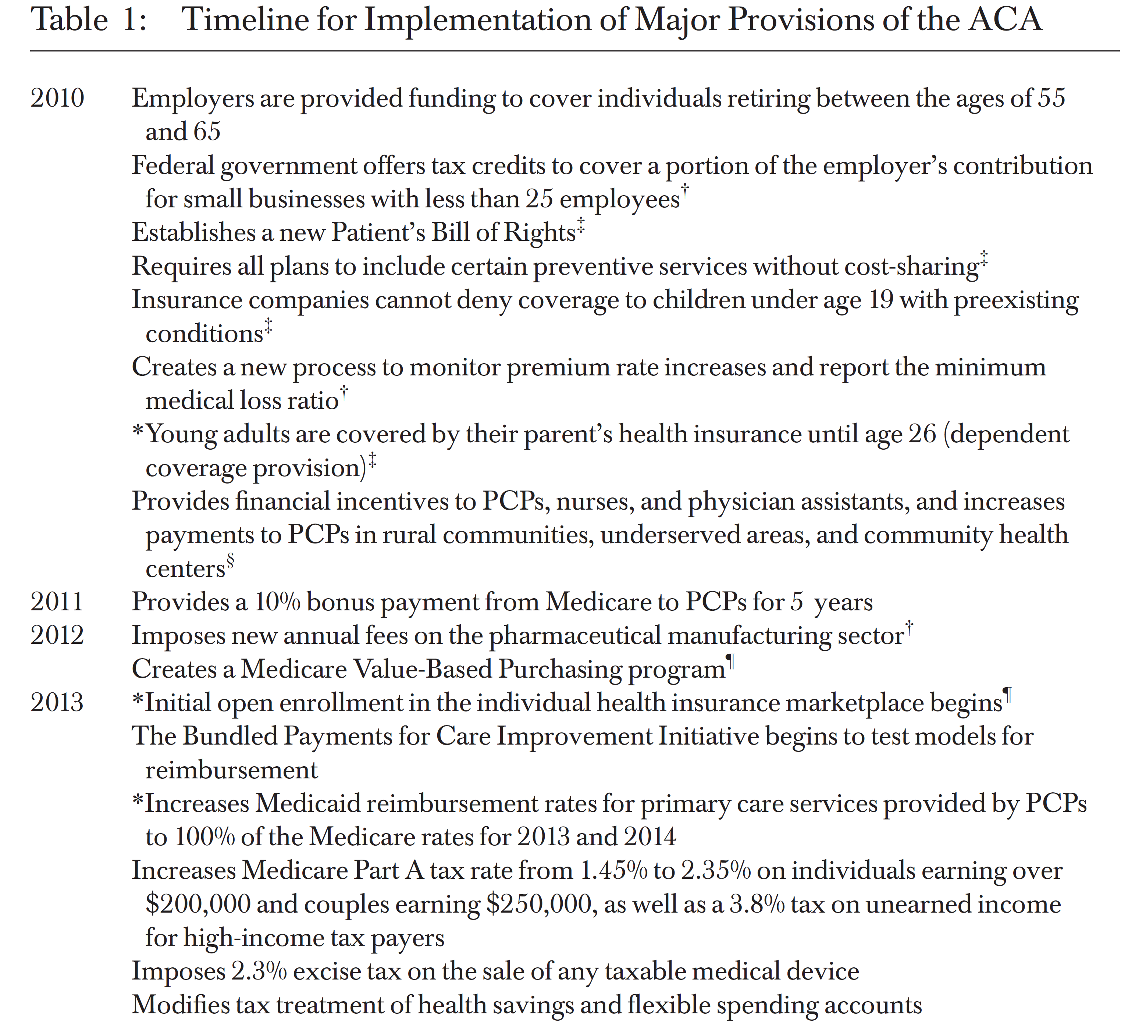

Source: Michael French et al, HSR, 2016.
http://onlinelibrary.wiley.com/doi/10.1111/1475-6773.12511/epdf

Slide 5
Source: Michael T. French et al, HSR, 2016.
http://onlinelibrary.wiley.com/doi/10.1111/1475-6773.12511/epdf

Slide 6
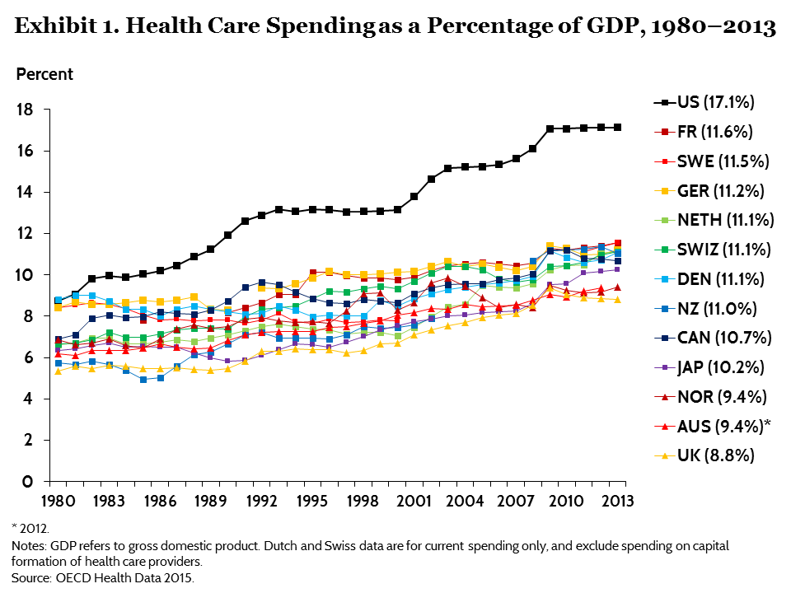

Slide 7
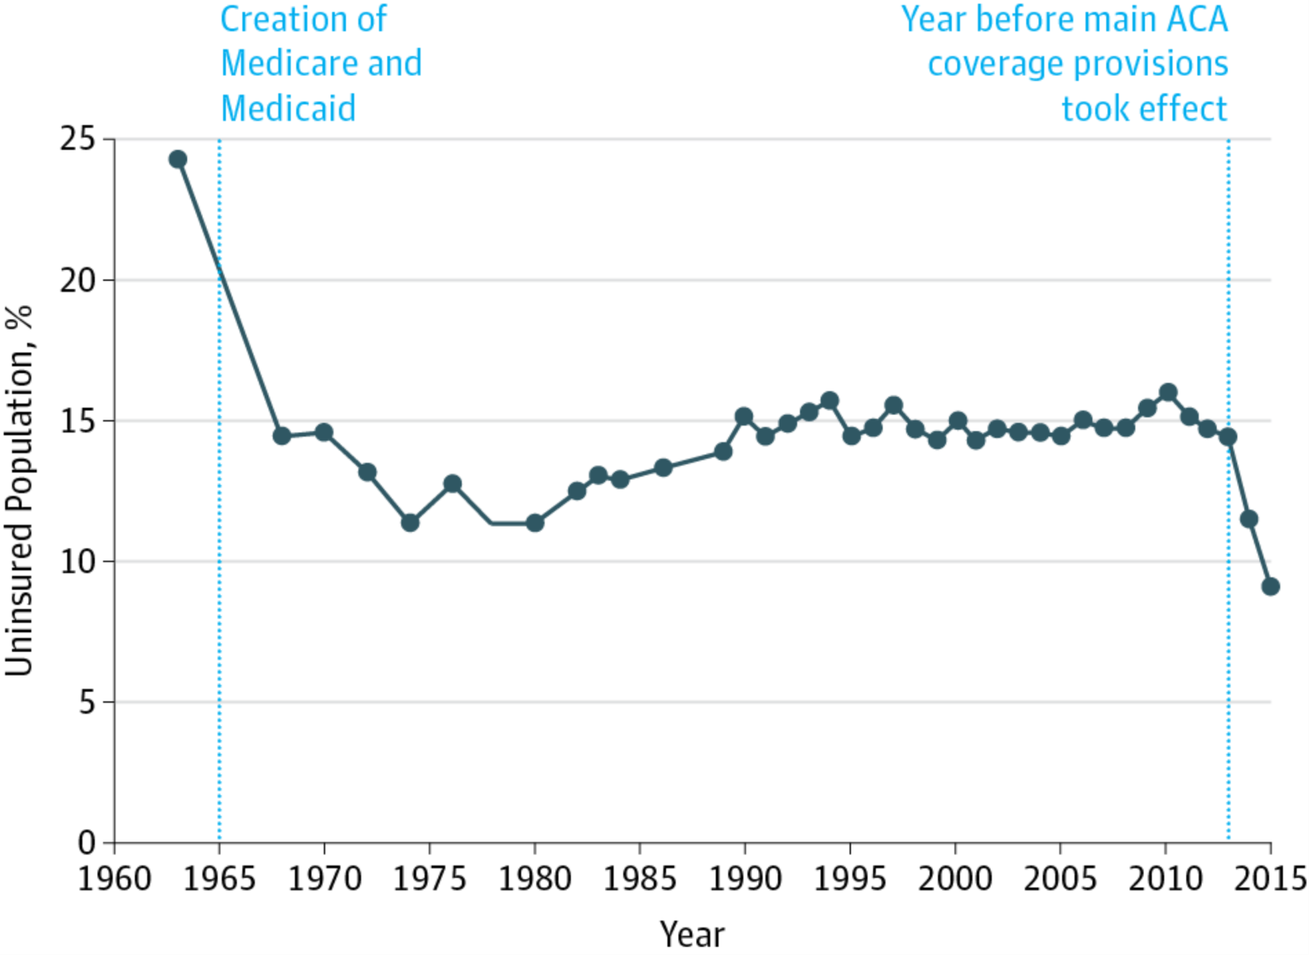
Primary focus of the ACA was to reduce the number of uninsured Americans
Obama B. United States Health Care Reform: Progress to Date and Next Steps. JAMA. Published online July 11, 2016. doi:10.1001/jama.2016.9797.

Slide 8
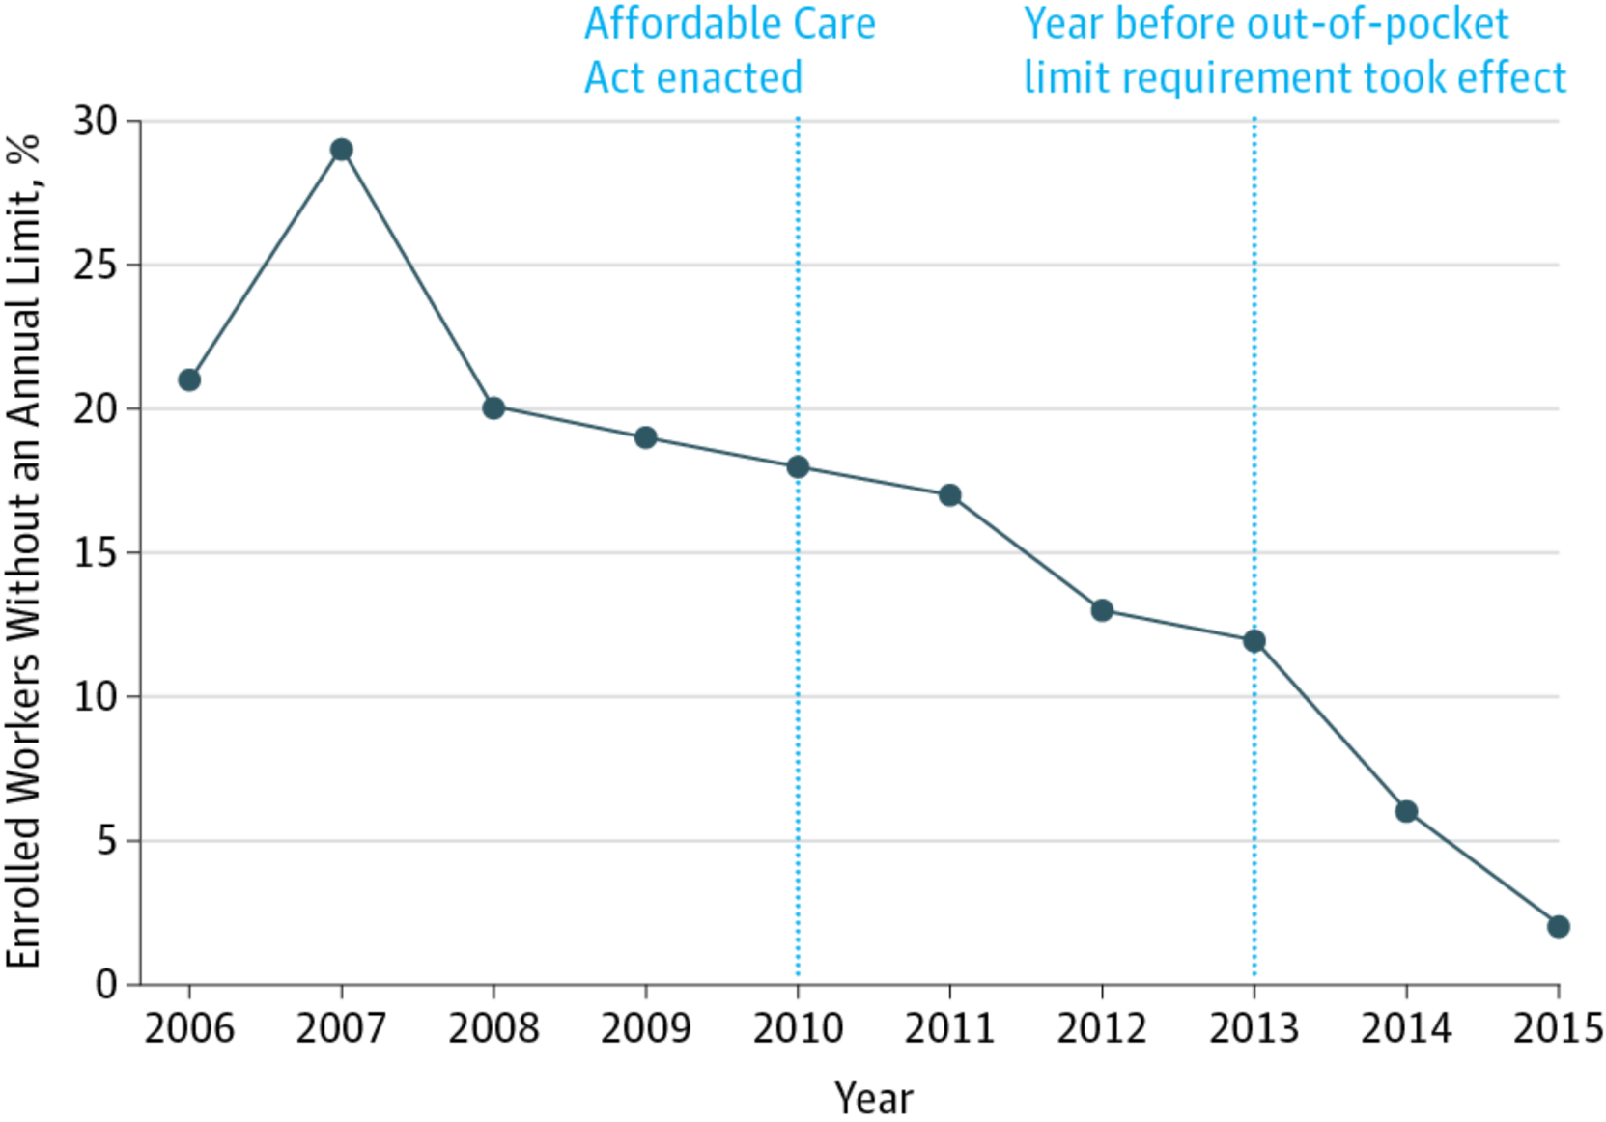
ACA also reduced the underinsured worker problem:
Workers with no limit on Out-of-pocket Spending declined
Source: Kaiser Family Foundation/Health Research and Education Trust Employer Health Benefits Survey, as presented in Obama (2016, JAMA IM)

Slide 9
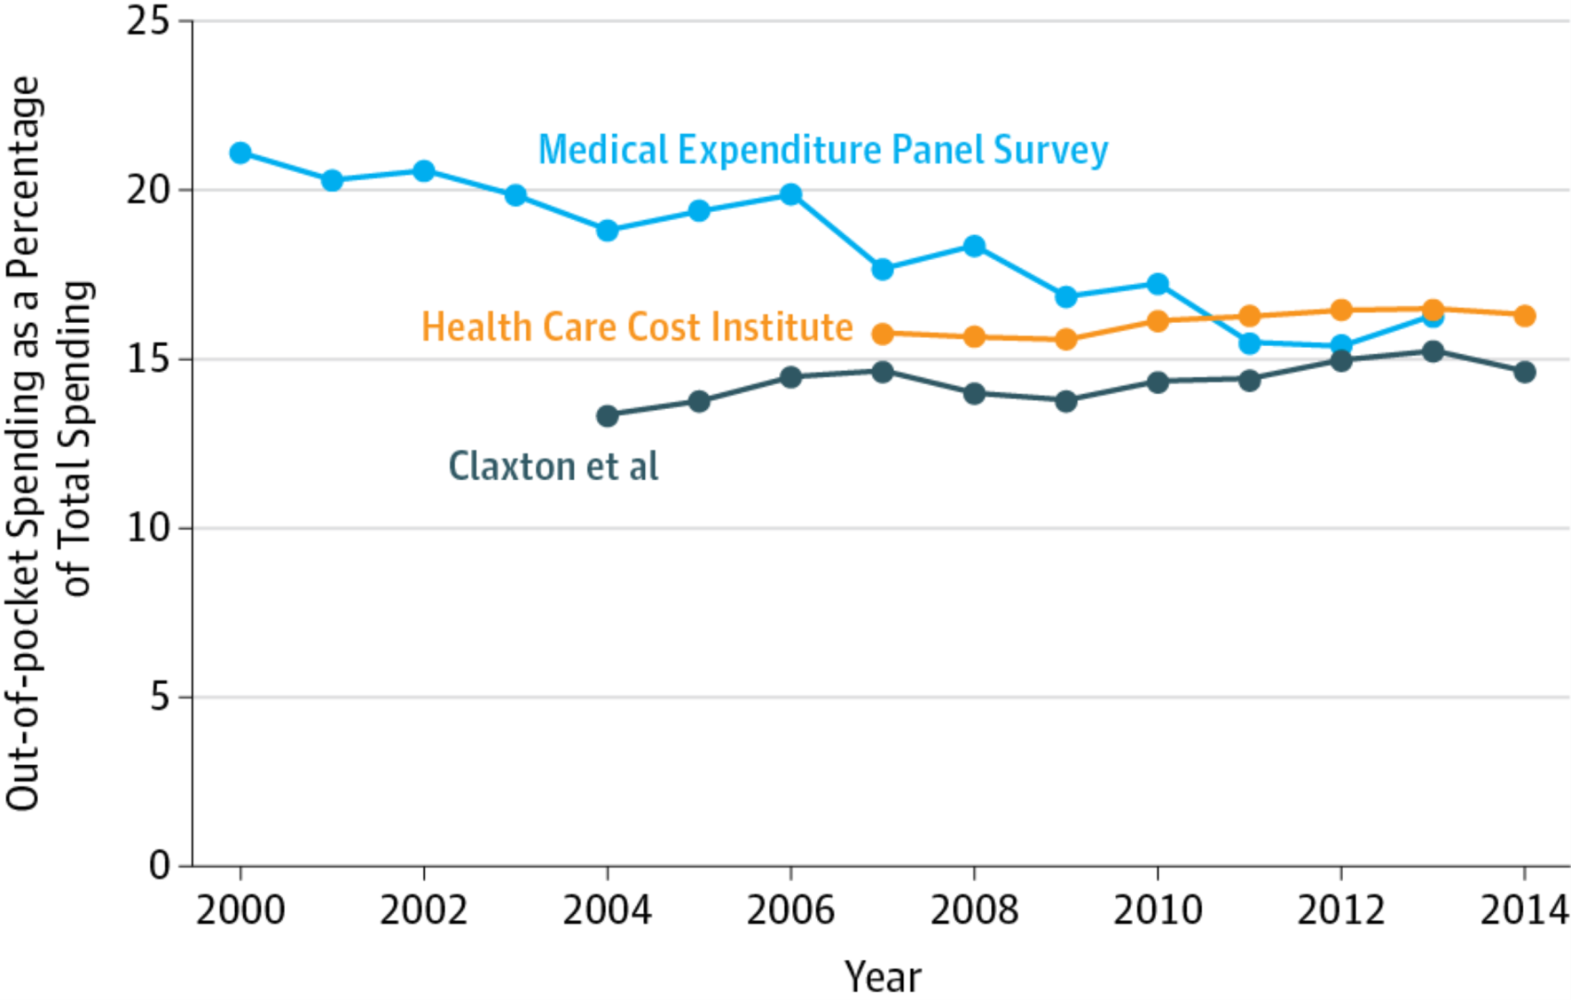
Despite anecdotal reports, average cost sharing has remained largely constant under the ACA, so cost containment is NOT by demand-side prices
Results are for Individuals with Employer-Based Coverage.
Three sources (MEPS, HCCI, and Truven MarketScan) as summarized in Obama (2016, JAMA IM).

Slide 10
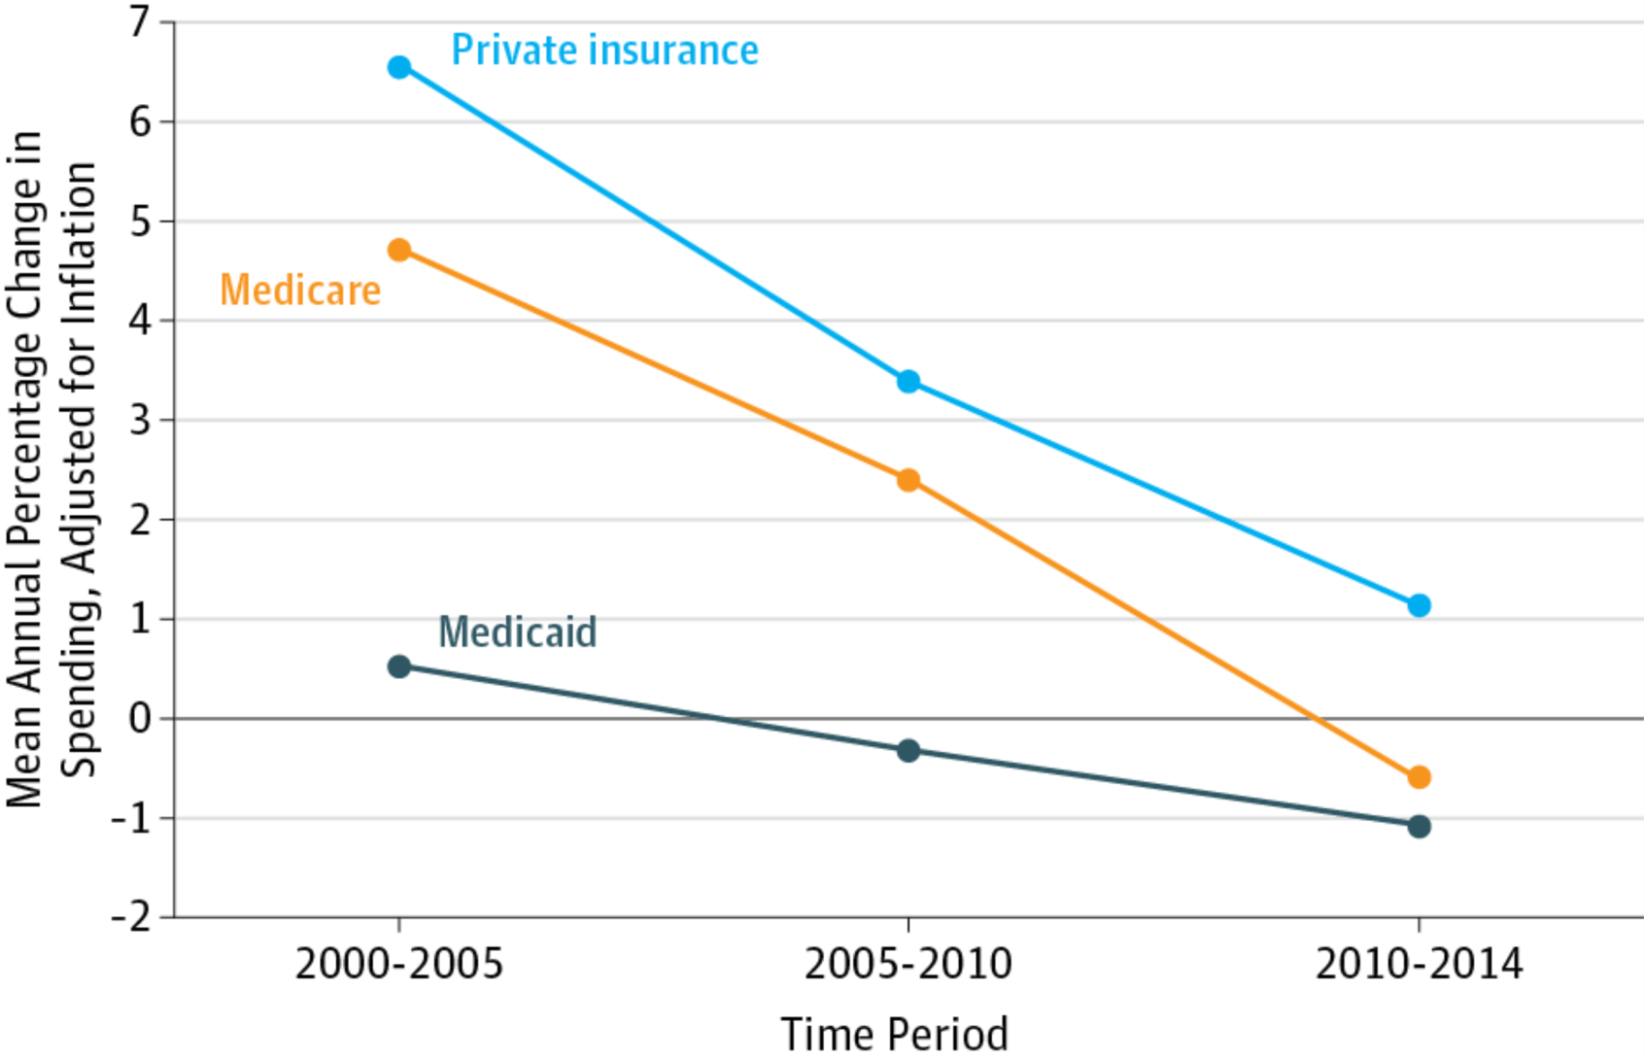
ACA slowed the real rate of increase in spending on health care per enrollee!
National Health Expenditure Accounts. Inflation adjusted using GDP Price Index. Medicare spending rate for 2005-10 omits 2005-2006 to exclude the effect of Medicare Part D. From Obama (2016, JAMA IM)

Slide 12


US slow down in health costs is mostly due to supply-side efforts
Medicare (Elderly and disabled):
Slower fee growth
Bundled payments (30% of all payments now)
Better fraud detection algorithms
Public posting of prices/procedures by MDs and hospitals
Increased use of competition
Medicaid (Poor and high health costs):
Huge growth in enrollment by relatively healthy enrollees
Increased use of managed care/bundled payments
Private sector (mostly employed):
Growth of managed care
Health Savings Accounts
Restrictions on plan profits
Health plan shopping on prices
Performance-based payments ?
Accountable Care organizations ??
Value-Based Insurance design ???

Slide 13
Preliminary Thoughts on
“Ten Strategies for Reducing US HealthCare Spending by 50%”
Randall P. Ellis, Ph.D.
Department of Economics
Boston University
Comments prepared for the OEPS
July 13, 2016

Slide 14
Time to take dramatic steps
Too many health policy changes adopt changes that will only reduce spending by a few percent.
Singapore and middle income countries achieve health outcomes that are about as good as the US on less than a third the cost.
How could we change things more dramatically here?

Slide 15
Many industries characterized by remarkable cost-reducing innovations
Goods
Computers
Cell phones
Electric cars
Solar panels
Services
Translation services via internet
Banking by phone
Engineering/Accounting/web design/data entry
Retail purchases
Uber
Lawyers
Why not health care?

Slide 16
Why not Health Care?
Will require disruptive innovation, which upsets the very well entrenched status quo
Lack of political leadership
Archaic, inflexible government regulations, maintained by political leaders who are captive to special interests
  Particularly at the state level in US
  Often only takes a few people on key committees to block
  Tiny donations can generate huge profits
Patent laws need reform
Lack of data or experience to explore alternatives
Lack of public discontent to motivate change (until recently?)

Slide 17
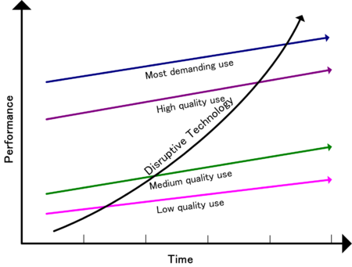
Disruptive innovation

Slide 18
Key Features of Disruptive Innovation
  New market and value network (e.g., iPod)
Often not advanced technologies, but rather novel combinations of existing technology
  (Uber, Translation via internet)
Initially unprofitable (e.g. electric cars, solar)
Risky to innovator (many failures)
Unprofitable for existing firms
Goal of regulations should be to enable DI

Slide 19
Current draft of ideas
Allow importing drugs from other countries
Shorten patent lives to 15 years.
Prohibit any fees that are more than XXXdoubleXXX existing Medicare fee scale, then work towards a single level of fees for all.
Insure all children as individuals not through parents policies, in a single payer system, with no cost sharing.
Relax regulations on new medical devices and drugs and allow riskier procedures and drugs
Standardize all health plans to have identical coverage, as they do in virtually every other developed country (other than Switzerland) (Eliminate strongest selection incentives)
Promote low cost providers.
  Retail clinics, midwifes, community hospitals.
Risk-adjust contributions to individual health savings accounts for all adults.
Impose a price ceiling of $30,000 per year for any one pharmaceutical unless a curative medicine for a rare disease or an expensive biological

Slide 20
Ten strategies in list form
Prices
Limit pharmaceutical and medical device prices
Remove fee-setting control from MD panels
Use bundled or mixed payment to providers
Regulations
Reform pharmaceutical/genetic manipulation patent laws
Relax regulation, licensing, and data-access rules for new technologies and “providers”
Allow lower quality health care provision
Promote Behavioral Economics approaches
Promote wise choices for end-of-life and beginning-of-life spending
Big Data
Faster/better fraud detection methods
Expand use of big data for decision support by innovators, consumers, providers and regulators

Slide 21
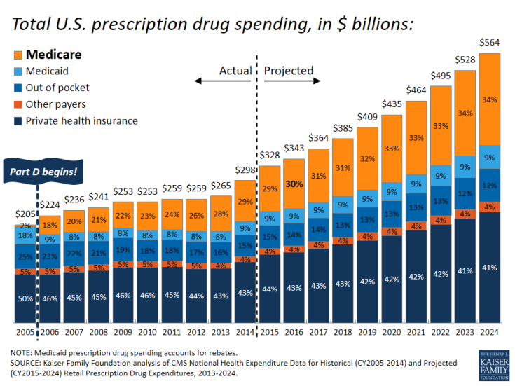
Today’s Chart Review 10 Essential Facts About Medicare and Prescription Drug Spending Kaiser Family Foundation
Surging growth in insured Medicare drug spending
Consumers paying declining share of costs

Slide 22
1. Limit pharmaceutical and medical device prices
Government should use its “monopsony power” to regulate prices for pharmaceuticals and medical devices.
Huge problem in the US that pharmaceutical companies get to choose prices of new drugs
Problem affects the rest of the world’s drug pricing and the direction of innovation
Prices currently reflect willingness to pay, which is enormous in the presence of prescription drug insurance
Need public, standardized price rules for new drugs, based on a schedule related to costs, not willingness to pay

Slide 23
4. Reform pharmaceutical/genetic manipulation patent laws
Customized medicine is just on the horizon
  Panacea or a problem?
Gene therapies are in the near future
Old pricing systems will not work
In danger of patent laws deeming all of these new products/genes patentable, and since individualized, not subject to easy entry or competition
New products only one program or gene change away
Will markets encourage multiple competitors?
What is willingness to pay (separately) to avoid cancer, asthma, hypertension, heart failure, arthritis, schizophrenia, depression, liver failure, kidney failure,…?
Need legal advice on what to suggest

Slide 24
2. Remove fee-setting control from MD panels
Procedure prices in the US set by a Relative Value Scale Update Committee (RUC) panel of physicians dominated by specialists, not PCPs.
Set prices
  too high for specialties services
  too low for primary care activities
Slow to update (lower) fees with technological change
Many of the latest innovations not amenable to per unit prices and Fee for service
  Home visits, phone calls, email, Skype, behavioral change
Already part of Affordable Care Act (ACA) but not implemented yet

Slide 25
3. Use bundled or mixed payment to providers
Lifetime focus of my research
If current spending on a service is X, then pay R+rX
where r is say .5 and R is a lump sum payment
Overprovision arises when prices > marginal cost
Don’t need to go all the way to capitation or fully bundled payments to eliminate incentives to overprovide
Pay 50% of average cost, 50% as a lump sum amount
This is called a mixed payment system (Ellis and McGuire, 1986)
Already used in Denmark, Norway, Germany, Canada, Iran

Slide 26
5. Relax regulation, licensing, and data-access rules for new technologies and “providers”
Retail health clinics and pharmacy “doc in a box” clinics
“Fitbots” and clinics need access to/data-sharing with medical record systems
Use of nurses instead of MDs for routine care (often state regulations)
Increased doctor specialization
  pathologists with less than MD training?
  pharmacist degree takes BA + 6 to 7 years?
Ability to go off-site for many services
  Radiology and lab test interpretation overseas (banking, accounting)
  Remote surgery (robotic surgery)
  Phone call and email visit reminders and follow-up calls
  Virtual conferences via conference call/Skype
  Noninvasive lab tests done by pharmacist, tested at lowest cost facilities
  (Your suggestions…)

Slide 27
6. Allow lower quality health care provision
Analogy: imagine you had food insurance which paid 95% of the cost of any food: what foods would you buy?
  Caviar, foie gras, truffles, lobster, champagne…
Now suppose your food plan would only cover you after you bought the first $5000 of food per year. Would you still want the same foods?
US health plans offer only one quality of health care, while offering many lower qualities of health insurance. People with lower quality health insurance would prefer lower cost (and quality) providers
  Private versus shared room
  Fewer amenities (TV with cable channels, constant nursing visits, luxury food)
  Choice of lower quality providers in exchange for lower fees
  This is what is done in Singapore

Slide 28
Other examples
Retail clinics have lower-trained professionals, but enormous convenience and lower costs
Future smart phones will access intelligent decision-making algorithms
“FitBits” and other personal health monitoring devices give lower quality advice than a physicians, but…
Medical advice provided online or overseas

Slide 29
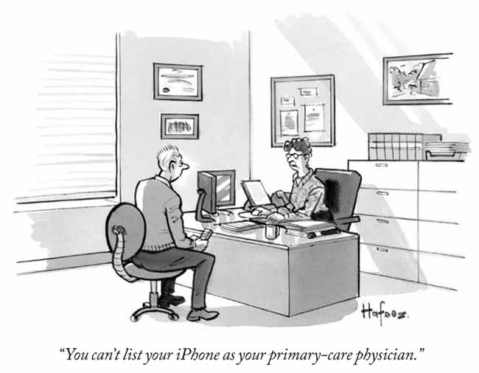
http://www.newyorker.com/cartoons/a19128

Slide 30
7. Promote Behavioral Economics approaches
Change decision structure to favor making the right choices
Enormous potential in making the defaults be lower cost and healthier
In US:
  Automatic savings
  Default health plan choices
  Follow-up visits
  Prescription drug refills
  Phone call reminders
  Health coach
  Checklists for doctors and hospitals

Slide 31
8. Promote wise choices for end-of-life and beginning-of-life spending
Headlines:
“The Cost of Dying” http://www.cbsnews.com/news/the-cost-of-dying/
  “Patients' Last Two Months of Life Cost Medicare $50 Billion Last Year; Is There a Better Way?”
“Birth Defects are Costly” http://www.cdc.gov/features/birthdefectscostly/
  “Heart defects: …about $1.4 billion in a single year (1).
  Spina bifida: …hospital costs for a typical baby … were about $21,900 (ranging up to $1,350,700) (2).
  Down syndrome: The medical costs … 12 to 13 times higher than a child without Down syndrome.”
“World’s first head transplant to be carried out on Chinese patient next year”16 May, 2016 (by an Italian MD) https://www.rt.com/news/343207-head-transplant-canavero-china/
“Just because you can, doesn’t mean you should.”
Need to think about specific strategies

Slide 32
9. Faster/better fraud detection methods
Many patterns of fraud can only be detected using big data and merging different datasets
  Multiple bills for the same service
  Billing for both bundled and unbundled procedures
  Too many services in one day
  Inconsistencies over time in treatments or drugs
  Implausibly high rates of use of archaic or high severity procedures
  Billings with a conflict of interest
  Not authorized to do procedure
  Fear of detection may be more important than actual punishments

Slide 33
10. Expand use of big data for decision support by innovators, consumers, providers and regulators
Big data can be used to predict almost anything
Claims information that is audited can be almost as useful as medical record information

Slide 34
Table 2. Factors associated with Intermediate outcomes, utilization, all cause mortality, and major coronary event
Score uses claims-based diagnoses
Kari Olson et al., 2015, Population and Health Management.

Slide 35
Table 2. Factors associated with Intermediate outcomes, utilization, all cause mortality, and major coronary event
Kari Olson et al., 2015, Population and Health Management.

Slide 36
Table 2. Factors associated with Intermediate outcomes, utilization, all cause mortality, and major coronary event
Kari Olson et al., 2015, Population and Health Management.

Slide 37
10. Expand use of big data for decision support by consumers, providers and regulators, and innovators
Big data can be used to predict almost anything
Claims information that is audited can be almost as useful as medical record information for prediction
US is now posting data publicly online for
  Individual MD use of specific procedures for Medicare
  https://www.cms.gov/research-statistics-data-and-systems/statistics-trends-and-reports/medicare-provider-charge-data/physician-and-other-supplier.html
  Individual MD acceptance of payments from any drug or medical device producer
  https://www.cms.gov/openpayments/
  Individual MD prescriptions of each drug
  https://www.cms.gov/Research-Statistics-Data-and-Systems/Statistics-Trends-and-Reports/Medicare-Provider-Charge-Data/Part-D-Prescriber.html
  Hospital and MD report cards
  Hospital compare: https://www.cms.gov/medicare/quality-initiatives-patient-assessment-instruments/hospitalqualityinits/hospitalcompare.html
  Physician compare: https://www.cms.gov/medicare/quality-initiatives-patient-assessment-instruments/physician-compare-initiative/
Huge interest in using Big Data to support medical decision-making

Slide 38
A few of the Big Players with Big Data
Google
IBM Watson
OPTUM
INTEL
Sanofi

Slide 39
Google
Google Health (2009-2011) ( early entry and exit on individual health records)
Google’s Seven New Ventures
  1. Genomics - lets consumers search their own DNA
  2. Cancer research - using Nanoparticles
  3. Health and Fitness - Google Fit app tracks movements
  4. Google Glass – virtual reality type eyewear permits remote viewing
  5. Telemedicine – Engadget is a self-diagnosis tool for consumers
  6. Smart Contact Lenses – to track Glucose levels
  7. Diagnostics sharing lab test results between patients and physicians

Slide 40
IBM Watson
A technology platform that uses natural language processing and machine learning to reveal insights from large amounts of unstructured data
Recently purchased Truven Analytics and their MarketScan database
In February 2013, IBM announced that Watson software system's first commercial application would be for utilization management decisions in lung cancer treatment at Memorial Sloan Kettering Cancer Center in conjunction with health insurance company WellPoint.
Other Watson Health partners include:
Medtronic : Predicting hypoglycemic episodes in diabetic patients nearly three hours before its onset, preventing devastating seizures.
Apple : Storing and analyzing ResearchKit data.
Johnson & Johnson: Analyzing scientific papers to find new connections for drug development.
Under Armour: Powering a “Cognitive Coaching System” that provides athletes coaching around sleep, fitness, activity and nutrition.

Slide 41
OPTUM
“A Health Services and Innovation Company”
Owns UnitedHealth Group, which serves 70 million people in the US
Also OptumInsight - Health data analytics
Active in the UK
“More than 800 antifraud professionals”
https://www.optum.com/solutions/plan-operations.html

Slide 42
INTEL
Health and Life Sciences Division
Life Sciences
Health IT
Medical Devices
Consumer Health
Focus is on Individualized medicine
http://www.intel.com/content/www/us/en/healthcare-it/healthcare-overview.html

Slide 43
Sanofi
#5 healthcare company in the world (36.4% in US)
Research areas
DIABETES
VACCINES & INFECTIOUS DISEASES
RARE DISEASES
IMMUNOLOGY & INFLAMMATION
CARDIOVASCULAR & METABOLISM
MULTIPLE SCLEROSIS
CANCER
NEURODEGENERATIVE DISEASES
OTHER HUMAN HEALTH OPPORTUNITIES
ANIMAL HEALTH
http://en.sanofi.com/

Slide 44
Figure 1: Four structures of health care payments

Slide 45
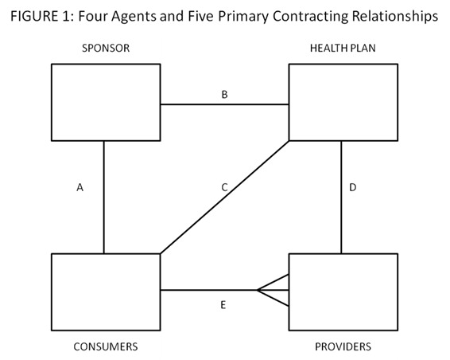
New digital entrants change the health care system
Google/
IBM Watson

Slide 46
Ten strategies in list form
Prices
Limit pharmaceutical and medical device prices
Remove fee-setting control from MD panels
Use bundled or mixed payment to providers
Regulations
Reform pharmaceutical/genetic manipulation patent laws
Relax regulation, licensing, and data-access rules for new technologies and “providers”
Allow lower quality health care provision
Promote Behavioral Economics approaches
Promote wise choices for end-of-life and beginning-of-life spending
Big Data
Faster/better fraud detection methods
Expand use of big data for decision support by innovators, consumers, providers and regulators
Randall P. Ellis, Ph.D.

