Slide 1
Adjectives of Feeling

Slide 2
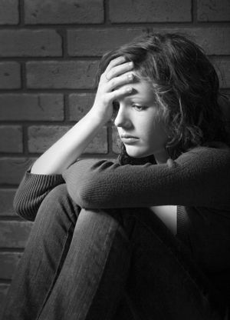

Slide 3
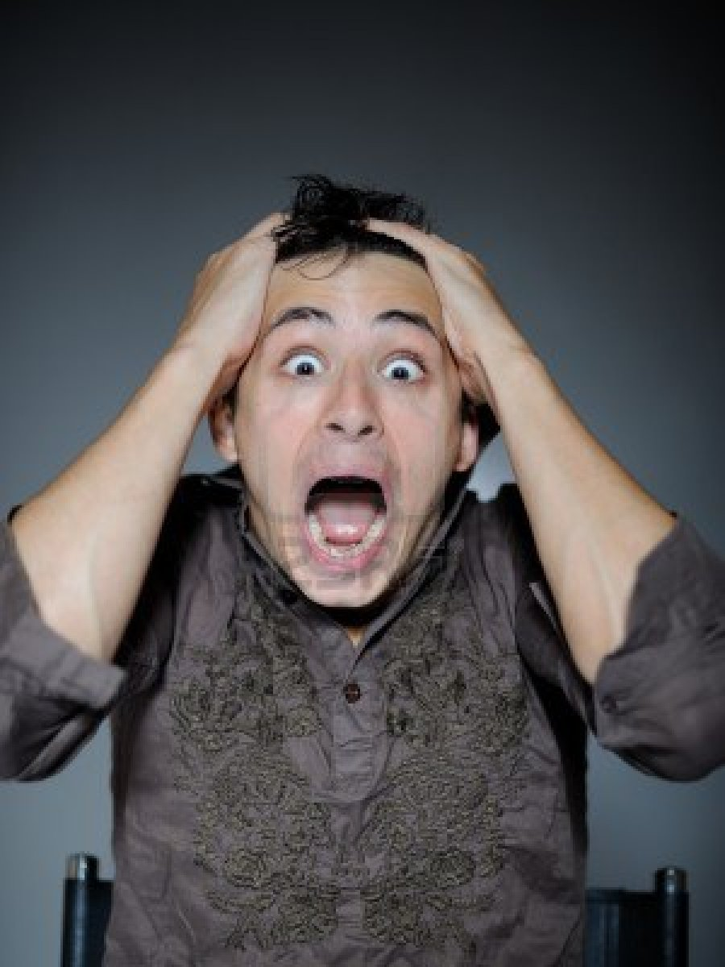

Slide 4
