Slide 1
The Auditory Kappa Effect in a Speech Context
Alejna Brugos & Jonathan Barnes
Speech Prosody, May 22, 2012
Shanghai, China

Slide 2
The perception of time

Slide 3
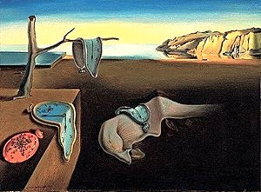
The perception of time
Measured time
≠
Perceived time

Slide 4
The interaction of pitch and timing
Dynamic F0 in speech can lead to longer perceived vowel duration (Yu, 2010; Cumming, 2011)
Non-speech research showing that pitch manipulations can alter perception of timing (Crowder & Neath, 1995 ; Henry, 2011; inter alia)
The auditory kappa effect
(Cohen et al., 1954; Henry & McAuley, 2009; inter alia)

Slide 5
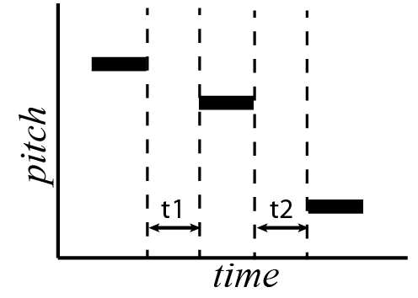
The auditory kappa effect
In a sequence of level tones, the relative frequency of the tones can distort the perception of silent intervals between them.
The two silent intervals t1 and t2
are of the same objective duration, but t2 is perceived as longer than t1
The mind expects that a greater pitch distance will take longer to traverse than a shorter distance, and adjusts perception accordingly.

Slide 6
Does the auditory kappa effect obtain in speech?
Conducted an experiment closely modelled after non-speech kappa studies
Sequences of short spoken words in place of short tones
Used concatenated AXB sequences
A, X, and B were all resynthesized versions of the spoken word one
Single-word full IP (H* L-L%)
To be speech-like (vs. sounding like singing)
Symmetrical rise-fall
From same 302 ms. naturally spoken base recording

Slide 7
The kappa cell paradigm
Following Shigeno, 1986; MacKenzie, 2007
In AXB sequences of sound events, A and B are fixed in pitch space, and in time relative to each other
Only the intermediate event X changes, in both time and pitch space
A
pitch
X
B
time

Slide 8
The kappa cell paradigm
Following Shigeno, 1986; MacKenzie, 2007
In AXB sequences of sound events, A and B are fixed in pitch space, and in time relative to each other
Only the intermediate event X changes, in both time and pitch space
A
pitch
X
B
time

Slide 9
The kappa cell paradigm
Following Shigeno, 1986; MacKenzie, 2007
In AXB sequences of sound events, A and B are fixed in pitch space, and in time relative to each other
Only the intermediate event X changes, in both time and pitch space
A
pitch
X
B
time

Slide 10
The kappa cell paradigm
Following Shigeno, 1986; MacKenzie, 2007
In AXB sequences of sound events, A and B are fixed in pitch space, and in time relative to each other
Only the intermediate event X changes, in both time and pitch space
A
pitch
X
B
time

Slide 11
Stimuli: timing & pitch steps
The whole rise-fall contour was shifted in 1 st. steps
Highest contour 8 st above base
Base contour had range of 150-200 hz
7 intermediate steps for X
AXB sequences concatenated with 2 intervening silences, t1 and t2
t1 + t2 always equal to 1000 ms.
10 time steps for each between 410 and 590 ms.

Slide 12
Stimuli: pitch change direction
2 directions: descending & ascending
A
B
pitch
pitch
X
X
B
A
time
time

Slide 13
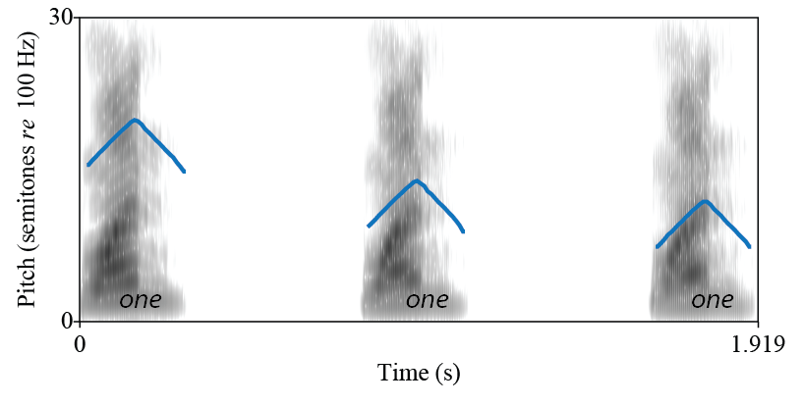
A sample stimulus
A
X
B

Slide 14
A sample stimulus
A
X
B
6 semitones
2 semitones

Slide 15
A sample stimulus
A
X
B
6 semitones
2 semitones
t1=490 ms.
t2=510 ms.

Slide 16
A sample stimulus
A
X
B
6 semitones
2 semitones
t1=490 ms.
t2=510 ms.

Slide 17
Task
Task: subjects asked to indicate whether the middle one was closer in time to the first or last one
Explicitly instructed to try to ignore pitch
31 subjects
16 for the ascending condition, 15 for the descending
All heard 4 repetitions of 70 stimuli
(7 pitch steps x 10 time steps)

Slide 18
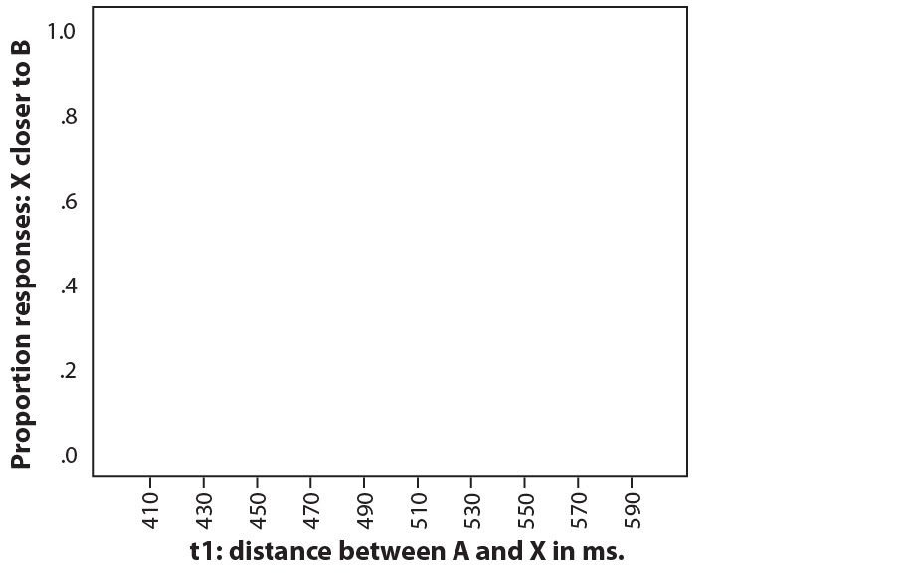
Results

Slide 19
Results
X sounds closer to B

Slide 20
Results
X sounds closer to A

Slide 21
Results
X is closer to A

Slide 22
Results
X is closer to B

Slide 23
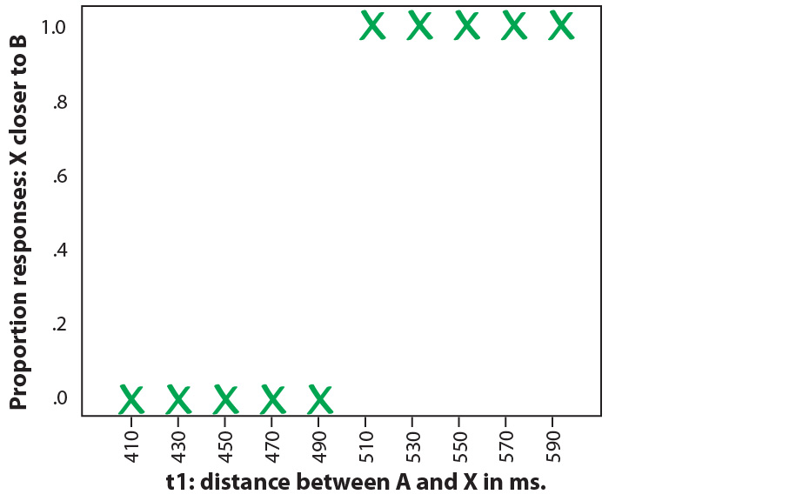
Idealized time perception

Slide 24
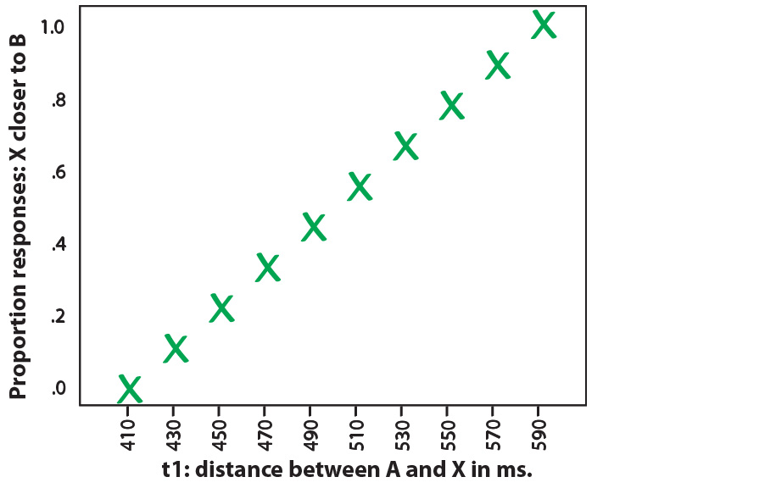
Expected time perception

Slide 25
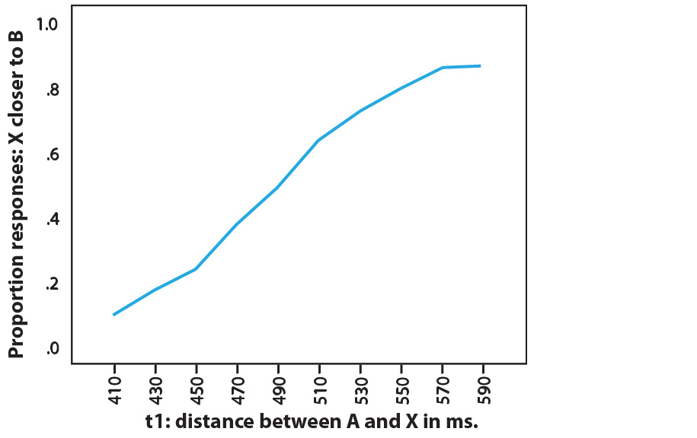
Results: all pitch steps merged

Slide 26
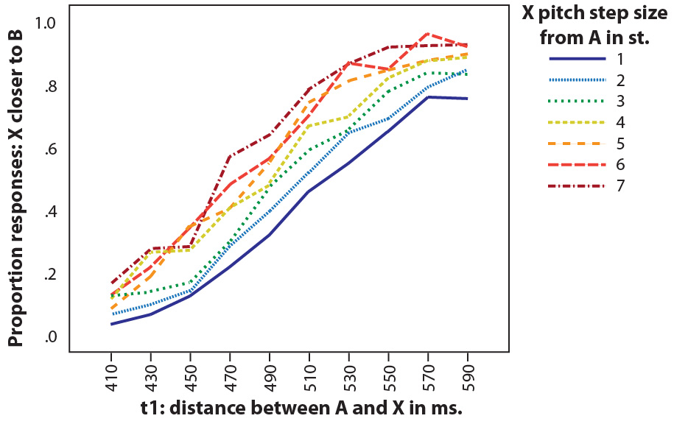
Results: time perception by pitch step

Slide 27
Results: time perception by pitch step

Slide 28
Analysis: The kappa effect obtains
Subject responses were based primarily on interval duration, but modulated by relative pitch.
As with the kappa effect in non-speech studies, perception of pause duration was distorted by pitch differences
→ Closer in pitch sounded closer in time.
Many possible directions to go…
Exploring the magnitude, robustness and generalizability of the effect
Order effects
Effect of pitch change velocity, length of material
Cross linguistic studies
How might these same manipulations affect linguistic judgments?

Slide 29
Follow-up experiment: Prosodic Grouping
Using the same materials, this time we asked subjects not about the timing of the words, but their “grouping”
Did the sequences of numbers sound like
(one one) (one) or (one) (one one) ?
Identical stimuli to the timing experiment
14 subjects, descending order only

Slide 30
Results: grouping perception
Proportion responses: X grouped with B

Slide 31
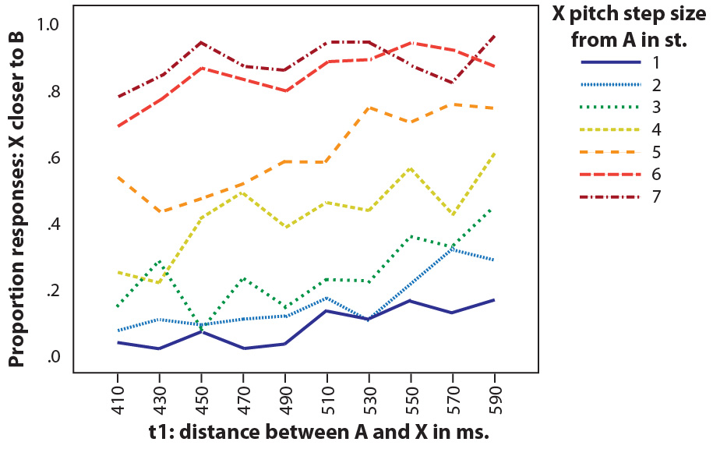
Results: grouping perception
Proportion responses: X grouped with B

Slide 32
Timing perception
Grouping perception

Slide 33
Analysis: grouping perception
Surprisingly, timing affected judgments of grouping fairly little
Items closer in pitch were perceived as grouped together
The results looking strikingly different from those of the time judgment task.
If the kappa effect is active in speech perception, this in itself is not sufficient to explain the results
The effect of pitch looks strikingly categorical
Only the middle (ambiguous) pitch steps showed a strong effect of time
It looks like pitch distance may have some sort of status of its own for prosodic grouping

Slide 34
Pitch, timing & grouping
F0 cues are recognized as important to grouping
Phrase accents and boundary tones (Beckman & Ayers Elam,1997)
Phrase-initial reset (Jun, 2006; Lin & Fon, 2011)
Pitch accent scaling (Ladd, 1988; Féry & Truckenbrodt, 2005)
Discourse segmentation (Oliveira & Cunha, 2004 ; Hirschberg, 2004; Carlson et al. 2005)
F0 cues are sometimes found to be secondary to timing ones
(Holzgrefe et al 2011; Hansson, 2003)
F0 omitted from some studies
Quantification of boundary strength based only on objective duration may miss powerful cues from F0.

Slide 35
Exploring pitch/time interaction
Investigations of pitch/time interaction in perception may:
Shed light on mismatches of duration and phrasing perception
Jumps in pitch across pauses may signal stronger boundaries
Steady pitch may signal weaker boundary than duration indicates
Contribute to our understanding of grouping across phrases
Compatible with boundary strength being inherently relative and grouping being recursive (Wagner & Crivellaro, 2010; Kentner & Féry, forthcoming)
We may consider pitch distance between phrases (with timing distance) in the light of principles of grouping:
Proximity & Anti-proximity (Kentner & Fery, forthcoming)
Gestalt principles of grouping (Lerdahl & Jackendoff, 1983; Wertheimer, 1938)
Auditory streaming, auditory scene analysis (Bregman, 1990)

Slide 36
Points of departure
Listeners are sensitive to F0, even when judging time
Perceived time is subject to F0-based distortions
Pitch and timing may be in a cue trading relationship (Beach, 1991)
Future directions:
Segmental length, boundary-related lengthening
Interaction of pitch jumps with F0 contour/boundary tone
Look for similar effects in other languages
Influence of temporal factors on perceived pitch (tau effect)
Look at production data, spontaneous speech
We should work towards a quantitative measure of boundary strength that incorporates aspects of both pitch and duration

Slide 37
Timing perception
Grouping perception
There is much to be investigated in the interaction of timing and pitch in speech perception.

Slide 38
Thank you!
Acknowledgments: This work was supported by NSF grant #1023853

Slide 39
Timing perception
Grouping perception
There is much to be investigated in the interaction of timing and pitch in speech perception.

Slide 40
References
Beach, C. (1991). The interpretation of prosodic patterns at points of syntactic structure ambiguity: Evidence for cue trading relations. Journal of Memory and Language, 30(6): 644–663.
Beckman, M., & Ayers Elam, G. (1997). Guidelines for ToBI Labelling. (v. 3).
Carlson, R., Hirschberg, J., & Swerts, M. (2005). Cues to upcoming Swedish prosodic boundaries: Subjective judgment studies and acoustic correlates. Speech Communication, 46(3-4), 326–333.
Cohen, J., Hansel, C. & Sylvester, J. (1954). Interdependence of temporal and auditory judgments. Nature, 174: 642–644.
Crowder, R. & Neath, I. (1995). The influence of pitch on time perception in short melodies. Music Perception, 12(4): 379–386.
Cumming, R. (2001). The effect of dynamic fundamental frequency on the perception of duration. Journal of Phonetics, 39(3): 375–387.
Féry, C. & Truckenbrodt, H. (2005). Sisterhood and tonal scaling. Studia Linguistica, 59(3): 223-243.
Hansson, P., 2003. Prosodic phrasing in spontaneous Swedish. PhD thesis. Lund University, Sweden.

Slide 41
Henry, M. & McAuley, J. (2009). Evaluation of an imputed pitch velocity model of the auditory kappa effect. Journal of Experimental Psychology: HPP, 35(2): 551–564.
Henry, M. (2011). A Test of an Auditory Motion Hypothesis for Continous and Discrete Sounds Moving in Pitch Space. PhD. Dissertation. Bowling Green State University.
Hirschberg, J. (2004). Pragmatics and intonation. The handbook of pragmatics, 515–537.
Holzgrefe, J., Schröder, C., Höhle, B. & Wartenburger, I. (2011). Neurophysiological investigations on the processing of prosodic boundary cues. ETAP 2, Montreal.
Jun, S.-A. (2006). Intonational phonology of Seoul Korean revisited. In T. Vance & K. Jones (Eds.), Japanese/Korean Linguistics 14 (p. 15-26). Stanford: CSLI.
Kentner, G. & Féry, C. (forthcoming). A new approach of prosodic grouping. The Linguistic Review.
Ladd, D. (1988). Declination ‘reset’ and the hierarchical organization of utterances.JASA, 84: 530-544.
Lerdahl, F., Jackendoff, R., 1983. A generative theory of tonal music. The MIT Press.

Slide 42
Lin, H. & Fon, J. (2011). The role of pitch reset in perception at discourse boundaries. ICPhS XVII, Hong Kong.
MacKenzie, N. (2007). The kappa effect in pitch/time context. PhD. Dissertation, Ohio State University.
Oliveira, M., Jr, & Cunha, D. (2004). Prosody As Marker of Direct Reported Speech Boundary. Speech Prosody.
Shigeno, S. (1986). The auditory tau and kappa effects for speech and nonspeech stimuli. Perception & Psychophysics, 40(1): 9–19.
Wagner, M. & Crivellaro, (2010). Relative Prosodic Boundary Strength and Prior Bias in Disambiguation. SpPros, Chicago.
Wertheimer, M. (1938). Laws of organization in perceptual forms. In: Ellis, W. (Ed.), A source book of Gestalt psychology. London: Routledge & Kegan Paul, pp. 71–88.
Wightman, C., Shattuck-Hufnagel, S., Ostendorf, M. & Price, P. (1992). Segmental durations in the vicinity of prosodic phrase boundaries. JASA, 91: 1707–1717.
Yu, A. (2010). Tonal effects on perceived vowel duration. In C. Fougeron, B. Kühnert, M. D’Imperio & N. Vallée (Eds.), Papers in Lab. Phon. (10). Berlin: M. de Gruyter.

