Slide 1
PO/WS 505: The 19th Amendment
Citizenship as Republican Motherhood Minus Rights:
Through the Early Republic

Slide 2
Agenda: Next Couple of Weeks
Before the suffrage movement: What were the conditions that women faced? In what ways were they engaged in politics before suffrage?
Christina Wolbrecht Lecture 4:00, CILSE 106B (6120 Comm Ave) Rhetoric and Reality: Women Voters Since Suffrage

Slide 3
Agenda: Today
Overview of our historical period.
Gender and the law, to 1788
Gender and socio-political roles, to 1788
The shifting landscape from the Revolution to the Jacksonian Era (1828-1850s)

Slide 4
Timeline
Identify an interesting historical story or two you see
OR
Identify a couple of interesting questions or puzzles the timeline raises

Slide 5
Gender & the Law 1608- 1788
Many systems of law operating simultaneously:
Tribal nations
Dutch
English
Common law
Equity law
Religious law
Different colonies/states

Slide 6
Gender & the Law 1608- 1788
Affects different groups of women differently:
Status of freedom: free, indentured, enslaved
Family status
Urban/rural
Wealth/property holding of the family

Slide 7
Exploring the legal principle of coverture: Do women exist as individual human beings under the law? The common law framework.

Slide 8
What is the common law? Where does it reside? What is the source of its force?

Slide 9
William Blackstone, Commentaries on the Law (1765-69)
“By marriage, the husband and wife are one person in law: that is, the very being or legal existence of the woman is suspended during the marriage, or at least is incorporated and consolidated into that of the husband: under whose wing, protection, and cover, she performs every thing; and is therefore called in our law-French a feme-covert; is said to be covert-baron, or under the protection and influence of her husband, her baron, or lord; and her condition during her marriage is called her coverture…..

Slide 10
William Blackstone, Commentaries on the Law (1765-69)
“…Upon this principle, of a union of person in husband and wife, depend almost all the legal rights, duties, and disabilities, that either of them acquire by the marriage. I speak not at present of the rights of property, but of such as are merely personal. For this reason, a man cannot grant any thing to his wife, or enter into covenant with her: for the grant would be to suppose her separate existence; and to covenant with her, would be only to covenant with himself: and therefore it is also generally true, that all compacts made between husband and wife, when single, are voided by the intermarriage.”

Slide 11
William Blackstone, 1723-1780

Slide 12
Summary: Significance & Impact of the common law principle of coverture
Property
Contracts
Employment
Separation of husband and wife
Control over children
Protection from violence within the bonds of marriage: abuse and rape

Slide 13
What were the main exceptions or variations for the impact of the common law?
Variations across jurisdictions
Applied only to “free” people: consider the relevant law as applied to enslaved people.
Implications differ depending on resources of individuals, access to courts.
Marital status matters in determining basic rights.
A husband’s beliefs, attitudes, behavior determines a woman’s rights/ situation.

Slide 14
Summary: What changed by the time of the rise of the Suffrage Movement?
Property
Contracts
Employment
Separation of husband and wife
Control over children
Protection from violence within the bonds of marriage: abuse and rape

Slide 15
Women’s Social Roles, Expectations, Situation: Beyond the Law
Relevant living situation in pre-industrial America: what was life like for women, men?
Women in public
Women and communication (or, we see you, Anne Hutchison)

Slide 16
Anne Hutchinson, 1581-1643

Slide 17
Women, Education, & Literacy

Slide 18
Women’s Socio-Political Roles through the Founding
Start with politics in narrowest sense: voting, campaigning, public speaking, governing.

Slide 19
Understanding Voting in Early America
Rules for participating varied across colonies, states
Major limitations meant not all white men had the vote
Property/ taxpaying qualifications
Having a “stake in society”
Being free and having sufficient independence to use judgment.
Servants
Literacy
Religious qualifications

Slide 20
Women & Elections
Citizens with “virtual representation.”
The New Jersey case
1790: “he or she”
1797: all qualified women
1807: Compromise leading to end of vote for women, African Americans.
Social realities of gender & voting

Slide 21
Conventional Political Roles
Petitioning
Parties and campaigns (how were they different in early America?)
(Understand shifts in the shape of party systems, elections):

Slide 22
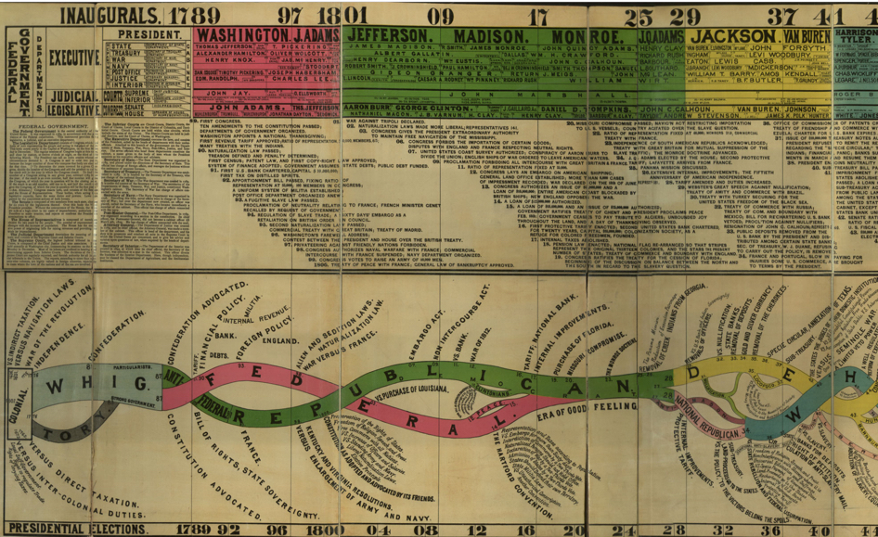

Slide 23
Gendered understanding of citizenship for women: Republican Motherhood

Slide 24
Daughters of Liberty, 1774 Woodcut

Slide 27
Nancy Hart Resisting Marauders, NC

Slide 29
A Society of Patriotic Ladies, 1775

Slide 30
What did the Revolution mean, specifically, to women?

Slide 31
What changed from the Revolution to the Jacksonian era and beyond? Why do folks identify 1848 – 72 years after the Revolution, at least 3 generations later, as “early stirrings?

Slide 32
We hear no longer of the alarming, and perhaps justly obnoxious din, of the ‘rights of women.’ Whatever [women’s] capacity of receiving instruction may be, there can be no use in extending it beyond the sphere of their duties.
….Historian Hannah Adams (1775-1831), written in 1832.

Slide 33
Hannah Adams, 1775-1831

