Slide 1
PO/WS 505: 19TH AMENDMENT
STATE-LEVEL WOMAN SUFFRAGE CAMPAIGNS ACROSS THE COUNTRY

Slide 2
Continue discussion from last week….

Slide 3
Silkey, Sarah. 1966. Black Woman Reformer: Ida B. Wells, Lynching, and Transatlantic Activism.

Slide 4
Julie Roy Jeffrey, “Women in the Southern Farmers’ Alliance: A reconsideration of the role and status of women in the late 19th century South.”

Slide 5
Martens, Allison M. 2009. “Working women or women workers? The Women’s Trade Union League and the transformation of the American Constitutional order."

Slide 6
Flanagan, Maureen A., 1990. “Gender and urban political reform: The City Club and the Woman’s City Club of Chicago in the Progressive Era”

Slide 7
Kathryn Kish Sklar, “Hull House in the 1890s: A community of women reformers.”

Slide 8
Taylor, Molly Ladd. 1991. “Hull House goes to Washington: Women and the Children’s Bureau.

Slide 9
Kathy Peiss, “Charity girls and city pleasures: Historical notes on working-class sexuality, 1880-1920.”

Slide 10
Dana Frank, “Housewives, socialists, and the politics of food: The 1917 New York cost-of-living protests.”

Slide 11
Mary J. Oates, “Organized voluntarism: The Catholic Sisters in Massachusetts, 1870-1940”

Slide 12
State-Level Woman Suffrage Campaigns

Slide 13
Review: Why/how did the efforts for constitutional change end around 1870?

Slide 14
What did the women’s rights/woman suffrage movements look like from 1870-1890?

Slide 15
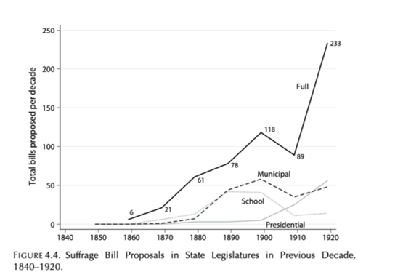

Slide 16
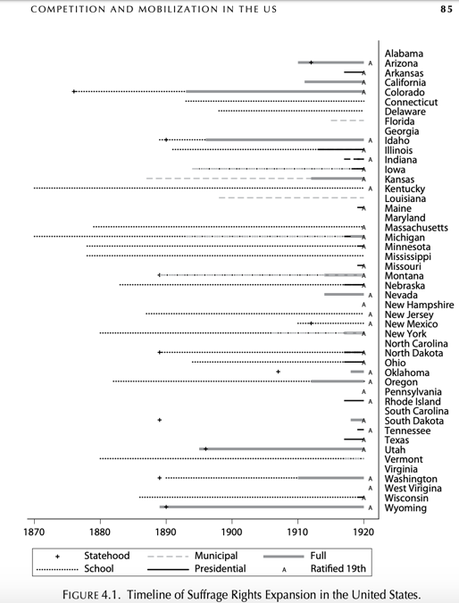

Slide 17
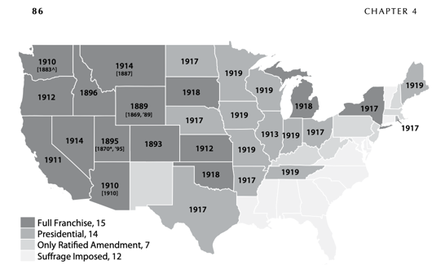

Slide 18
Hypotheses: State-Level Successes, Failures: Hypotheses
Ideology: Attitudes toward women’s rights.
Organizational capacity of women’s movements
Strength of opposition organizations

Slide 19
Hypotheses: State-Level Successes, Failures: Hypotheses
Threats of violence, disorder
Incentives, motivations of legislators
Strategic enfranchisement
Programmatic enfranchisement

Slide 20
Discussion of The Woman Suffrage Movement in America

