Slide 1
TIME Magazine
“Bitter Pill: Why Medical Bills are Killing US”
By Steven Brill
March 4, 2013 p. 16-55
Slides by Randall P Ellis
Economics Department
Boston University
(Drawing upon ppt slides of Calvin Luscombe)

Slide 2
Case Studies
Sean Recchi: 42, small business, private insurance, but coverage limit of $2000/day for IP care
  Cancer: Billed $83,900 OOP in advance.
Janis S: 64, unemployed, uninsured.
  Heart Burn: Billed $21,000 OOP.
Emilia Glibert: 60ish, school bus driver, no insurance.
  Slip and fall, One day treatment: Billed $9,400 OOP.

Slide 3
Case Studies
Steve, H: blue collar union worker, private insurance, but $60,000 payout limit of union policy.
  Spinal stimulator: Billed $87,000; paid $10,000 OOP.
Steven D: Terminally ill, private insurance, but $50,000 maximum coverage
  Lung Cancer: Billed $902,000; paid $172,000 OOP by family.
Scott S: 50’s, private insurance, but $100,000 maximum payout
  Pneumonia: Billed $474,000; paid $313,000 OOP

Slide 4

Case Studies
Alan A: 88, Medicare
  Heart attack: Billed $268,000; Medicare paid $43,000; OOP less then .02%

Slide 5
The Chargemaster
Hospital Price guide
  Not based on cost
  Not used for Medicare reimbursements
Used as starting price in payment negotiations
  Assuming agent aware they are bargaining.
Used to help justify charitable donations
Zero transparency (HIPPA Shield)
  Every hospital has its own, unique Chargemaster

Slide 6
Chargemaster Vs. Medicare
Example fee comparison (Chargemaster VS Medicare)
  Troponin (measures protein in blood):
    $199.50 VS $13.94
  Electrocardiograph (lab test)
    $1,200 VS $96
  Triple CT scans (Head, Chest, Face)
    $6,538 VS $825

Slide 7
Pay No Attention To The Chargemaster ”These are not the droids you’re looking for.” - Star Wars
Representatives avoid explanations about the Chargemaster.
Justification of high rates include:
  Almost no one pays them
  At least then everyone receives the same bill
  We use these rates to charge rich foreigners and subsidize treating the poor
  They are a starting point for negations not a final offer

Slide 8
Exorbitant fees may have resulted from hospitals gaming the Medicare DRG outlier formula
Hospitals in US are paid primarily a lump sum Diagnosis Related Group (DRG) payment for each admission. Receive 80 percent of any excess of costs above a high threshold ( e.g., when more than $25,000 over the DRG payment)
Hospital “costs” determined by taking their submitted charges, and multiplying them by the LAGGED hospital Cost to Charge ratio.
It is profitable to keep increasing submitted charges to stay ahead of the CCR_{t-1}.

Slide 9
Too Big To Regulate
Large employers
Positive local reputation
Threat of reducing services to poor

Slide 10
Medical-billing advocates
Negotiate for reductions in charges
Seton hospital accepts a 82% average discount on its charges
Appear to bring huge value to their clients
New to me

Slide 11
Cash Crop: Durable Medical Goods
Medtronic: Profit margin 75% vs. Apple 40%
Congress protected profit
Payments to physicians
  Stock options
  Royalty agreements
  Consulting agreements
  Research grants and fellowships
Sunshine laws?
Notes:
(Medtronic post conflict of interest info makes problem less severe)

Slide 12

Better Safe Than Sorry: Malpractice
Technological advance: high cost but not necessarily high benefit.
Hospital CEO says: “We can’t be sued for doing too much.”
Practical Proposal: Safe Harbor
Notes:
Medical malpractice

Slide 13
Is It Really Nonprofit?
Nonprofits not prohibited from earning more than costs.
  BOA survey: nonprofit more profitable than for profit after tax deductions
  Excess revenue increases executive salaries, expands facilities, buys rival hospitals.
Example: Stamford nonprofit hospital in Conn.
  12.7% operating profit
  CEO earns $1.86 mil/year
  99.4% revenue from patients bills

Slide 14
But Medicare Doesn’t Pay Enough
Stamford Hospital
  serves 50% Medicare and Medicaid patients
  Operating profit margin of 12.7%
For-profit Hospitals accept them and even advertise to them.

Slide 15
What Can Be Done?
According to Brill:
Tighten antitrust laws related to hospitals
Tax hospital profit at 75%.
Increase tax on non-doctor salaries over $750,000/year
Outlaw Chargemaster
Limit wonder drug monopoly/patent power
Cap CT and MRI payments, tighten Medicare
Safe Harbor for physicians

Slide 16
Princeton Economist Uwe Reinhardt’s approach
Make it illegal for hospitals to charge uninsured people more than X percent of what Medicare pays for a procedure.
What is a reasonable magnitude for X?
Uwe Reinhardt Shocked, Shocked. over Hospital Bills. New York Times Economix Blog. March 1, 2013

Slide 17
Uwe Reinhardt’s approach
Professor Reinhardt served on a state commission that helped guide the state of New Jersey to enact such legislation in 2008.
Former Gov. Jon Corzine of New Jersey worked with the state Legislature to enact Assembly Bill No. 2609.
The bill limits what New Jersey hospitals can charge uninsured New Jersey residents with gross incomes up to 500 percent of the federal poverty level: no more than 115 percent of the applicable payment under the federal Medicare program.

Slide 20
Other problems with US
All of the prices featured in the Brill article are for people paying prices not negotiated by their health plan. Few people do indeed pay such high prices.
But there are other problems with fees being simply too high.
  Fees unreasonably high when there is market power
  Providers often able to upcode the number and intensity of services they provide.

Slide 21
When considering antitrust for price setting and monopolization, what is the relevant market?
Consider the proposed acquisition of three practices with TEN primary care physicians (PCPs). Will this unduly increase a provider networks market power?
Market is Massachusetts, all physicians:
29,000 physicians in Massachusetts
1203 MDs in Essex County
493 PCPs in Essex County
36 PCPs in the three towns where they are locating?

Slide 22
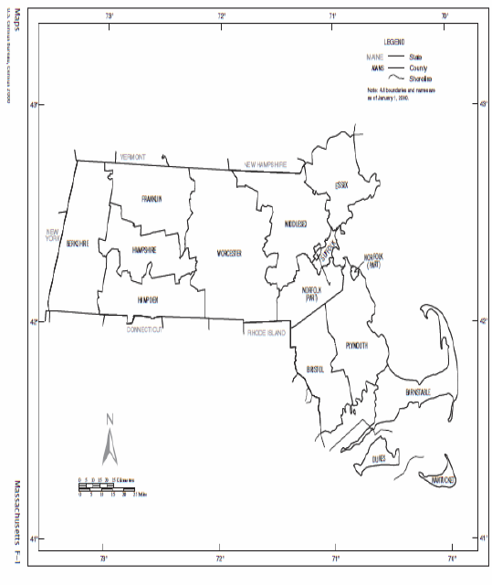

Slide 23
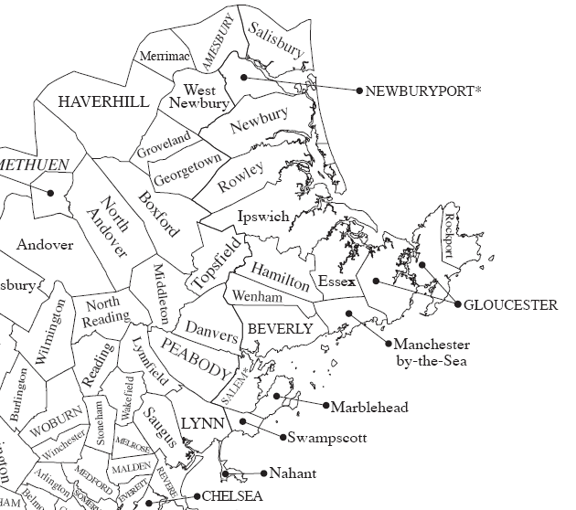
Map of North Shore cities and towns
Source: http://www.sec.state.ma.us/cis/cispdf/ma_city_town.pdf

Slide 24
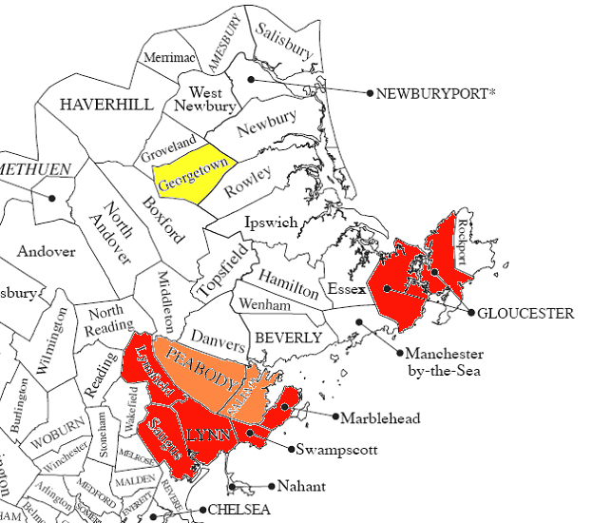
Town-level market shares BEFORE proposed merger

Slide 25
Town-level market shares AFTER proposed merger

Slide 26
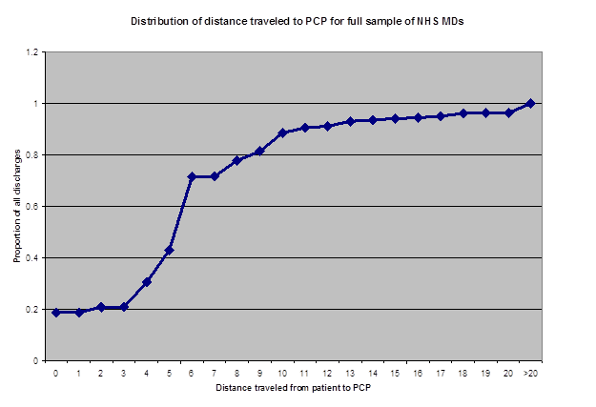

Slide 27
Massachusetts faces a crisis?!?
Table 1.1 Physician Specialties Categorized as Critical or Severe in 2011 Massachusetts Medical Society Survey
Specialty
Dermatology Severe
Family Medicine Severe
General Surgery Severe
Internal Medicine Critical
Neurosurgery Severe
Orthopedics Severe
Psychiatry Critical
Urology Critical

Slide 28
17 percent reduction in visits from 2008 to 2012
British Medical Journal Article:
US physician hours and visits still down 17% in 2012.
October 11, 2012 at 8:01 am
US physicians work fewer hours and see fewer patients than in 2008
Edward Davies
BMJ 2012; 345 doi: http://dx.doi.org/10.1136/bmj.e6863 (Published 10 October 2012)
“Between 2008 and 2012, the average number of hours physicians worked fell from 57 hours a week to 53, and doctors saw 16.6% fewer patients. The research, based on a survey of 13 575 physicians across the US, estimates that if these patterns continue 44 250 full time equivalent (FTE) physicians will be lost from the workforce in the next four years.
More than half of physicians (52%) have limited the access of Medicare patients to their practices or are planning to do so, while one out of four physicians (26%) have already closed their practices altogether to Medicaid patients, the survey shows. Physicians cited rising operating costs, time constraints, and diminishing reimbursement as the primary reasons why they are unable to accept additional Medicare and Medicaid patients.”
The survey was fielded online from late March to early June 2012 by Merritt Hawkins for the Physicians Foundation

