Slide 1


Navigating your way through the Scientific literature:
A Biostatistician’s Guide
David R. Gagnon, MD MPH PhD
Boston University
Massachusetts Veterans Epidemiology Research and Information Center [MAVERIC]

Slide 2
Q: Where should we look? A: Reputable journals
  Impact factor
  Defined as the average number of citations a paper would have two years after publication.
  How to “Game the System”
    “Suggest” that authors submitting to a journal cite other articles in that journal. Called “coercive citation”
  From Retractionwatch.com
    “It has been brought to the attention of the Journal of Parallel and Distributed Computing that an article previously published in JPDC included a large number of references to another journal. It is the opinion of the JPDC Editor-in-Chief and the Publisher that these citations were not of direct relevance to the article and were included to manipulate the citation record”
    One of the authors was the editor of the cited journal

Slide 3
Unintended Consequences
From a talk by Donald R. Paul cited by A. Maureen Rouhi
A minimum necessary requirement for graduation with a PhD from this group is to accumulate 20 IF (impact factor) points, and at least 14 of which should be earned from first-author publications.”
Ninety percent of Nature’s 2004 impact factor was due to 25% of its articles.
In a study by the editors of Infection and Immunity
Retraction rates are correlated with impact factor
  High retraction rates are related to high impact factors.

Slide 4
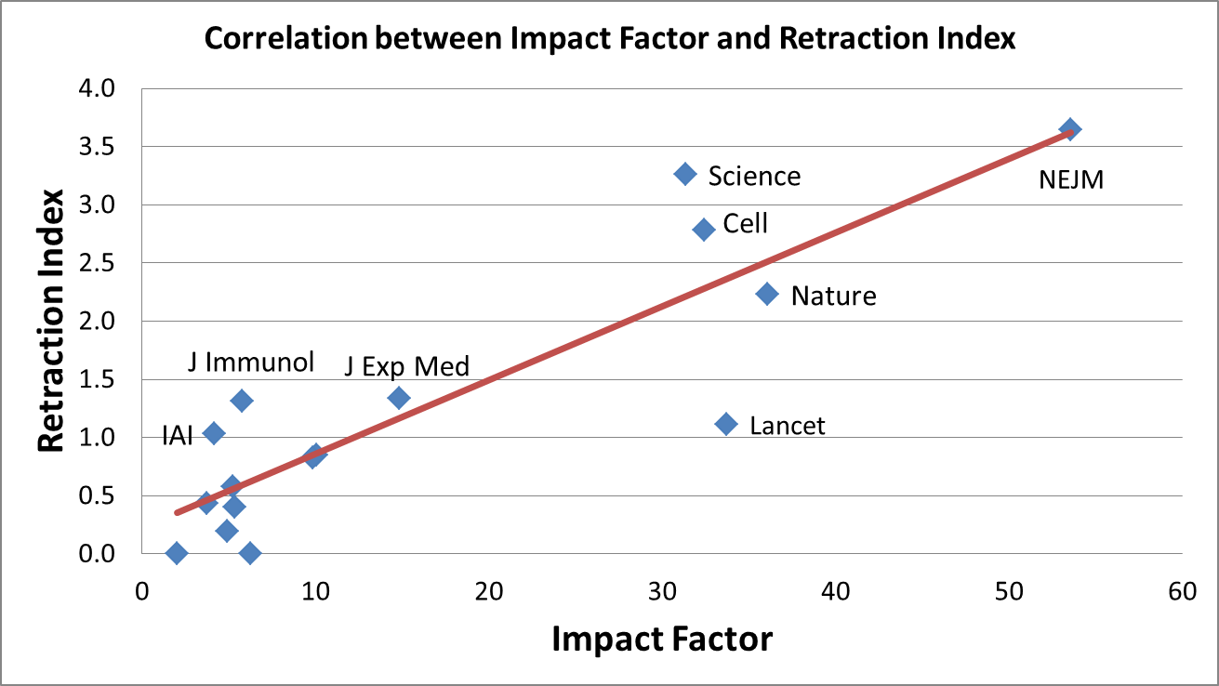
From: Fang F C , and Casadevall A Infect. Immun. 2011;79:3855-3859
Notes:
Correlation between impact factor and retraction index. The 2010 journal impact factor (37) is plotted against the retraction index as a measure of the frequency of retracted articles from 2001 to 2010 (see text for details). Journals analyzed were Cell, EMBO Journal, FEMS Microbiology Letters, Infection and Immunity, Journal of Bacteriology, Journal of Biological Chemistry, Journal of Experimental Medicine, Journal of Immunology, Journal of Infectious Diseases, Journal of Virology, Lancet, Microbial Pathogenesis, Molecular Microbiology, Nature, New England Journal of Medicine, PNAS, and Science.

Slide 5
Also from Fang et al.
Retraction rates are 10x higher than 10 years ago [from RG Steen in J Medical Ethics]
Reasons for seeing more retractions in top journals:
“Publish or perish” means
  Hasty publication causing errors
  Fraud
Popular journals get read by more people – increased detection of errors and fraud.

Slide 6
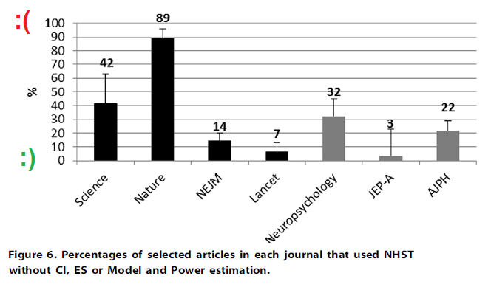
Better journals, worse statistics?
From Neuroskeptic in Discover Magazine (Feb 19, 2013)

Slide 7
Who should you trust?
Impact factor probably does reflect “quality” to some degree.
  While they may get the most “cutting edge” science, you may have to go elsewhere to find the “rest of the story”
Longevity of a journal has some relevance
  Be careful of journals at “Volume 2” with no track record.
  Many journals are popping up
    No paper editions, so really cheap to produce
    High application fees
    Little editing oversight

Slide 8
Statistical reviews are important!
From badscience.net , by Ben Goldacre, MD
Group 1 is significantly different from null {1}, Group 2 is not. Therefore, Group 1 and Group 2 are different. ERROR!!!

Slide 9
From: Nieuwenhuis S, Forstmann BU,Wagenmakers EJ. Nature Neuroscience 14, 1105–1107 (2011)
Reviewed 513 articles in five top neuroscience journals
157 articles made similar comparisons
50% got it wrong.
In 120 articles in Nature Neuroscience
25 made this error
None did a correct analysi
Statistical reviews would have prevented this

Slide 10
Common Errors: Chance
 | The TRUTH:
The Test | Null is True | Null is False
Reject the null Hypothesis | Type I Error P-value | OK
Accept the null Hypothesis | OK | Type II Error Power

Slide 11
Interpreting the p-values you get
A p-value is the p(type I error) given everything else is perfect. Confidence intervals can be more informative.
Estimate RR (95% CI) | Interpretation
1.05 (1.02-1.09) | Statistically significant, probably clinically irrelevant
3.0 (0.7-11.7) | Large but insignificant effect – need a bigger study.
1.3 (0.78-2.17) | Uninformative null result – doesn’t tell you much.
1.5 (1.2-1.9) | Significant , modest effect

Slide 12
Multiple testing leads to more type I errors
We generally accept a 5% chance of a type I error on any test.
  P < 0.05
If we do more tests, each one has a 5% of being falsely significant.
    P(at least one type I error) = 1-(0.95)^{N}
      Where N=number of tests

Slide 13
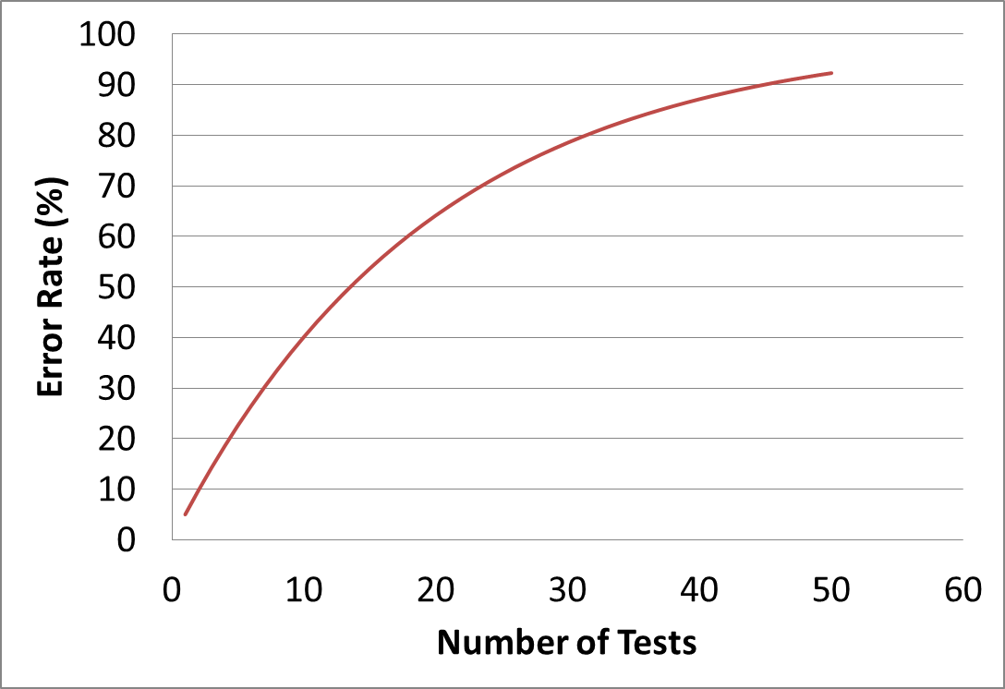
Chance of at least one Type I Error by Number of Tests

Slide 14
Chance and Multiple Testing Problems:
The Extremes
Baird AA, Miller MB, Wolford GL.
Neural Correlates of Interspecies Perspective Taking in the Post-Mortem Atlantic Salmon: An Argument For Proper Multiple Comparisons Correction. J Serendipitous and Unexpected Results
fMRI scans of a dead salmon showed a “response” to visual stimuli.
This results from 130,000 voxels being tested at α=0.05.

Slide 15
Chance: Fixing the problem?
In some cases, you accept the fact that you’ve done a lot of testing
Consider it “exploratory”.
Don’t fall in love with the results
Look for consistency
Otherwise, you try to fix it
Change your alpha level to something < 5%
  Especially true with expensive clinical trials
Use tests that properly adjust for multiple tests

Slide 16
Chance strikes again: Publication bias
Not all studies are published
  Significant results are three times more likely to be published than non-significant results.
The first studies published are more likely to be significant.
  These first studies are often published in high impact journals
  Later studies will show up as negative and in lower impact journals
    Fewer people will see them
    They won’t end up in the NY Times.

Slide 17
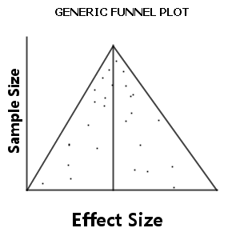
Funnel Plots for Detecting Publication Bias

Slide 18
The Decline Effect
JPA Ioannidis. Contradicted and Initially Stronger Effects in Highly Cited Clinical Research JAMA. 2005;294(2):218-228
49 “highly cited original research studies”, 45 positive
High impact journals, > 1000 citations
N (%) | Finding
7 (16) | Later contradicted by other studies
7 (16) | Later studies showed weaker associations
20 (44) | Later replicated with similar results
11 (24) | Never really challenged

Slide 19
Notable studies contradicted
Nurses Health Study [ NHS, observational]
44% risk reduction for coronary artery disease on HRT
Women’s Health Initiative trial showed 29% risk increase.
Health Professionals Follow-Up Study [obs.], NHS, CHAOS [trial].
Found vitamin E reduces CAD risk by 47%
Larger trial showed no cardiovascular benefit
SELECT trial stopped as vitamin E associated with increased risk of prostate cancer

Slide 20
Declining Study Effects Over Time
Early publications can have strong, significant results
Over time, other studies can find diminished or null effects
  May be due to publication bias.
    Smaller original studies can have unstable results – the most extreme are published first
  Later studies may have methodological differences that explain the earlier effects.
  Surrogate marker studies are a prime target for contradictions

Slide 21
Declining effects: The fix?
Studies need to be repeated, but who will pay?
Multi-center randomized trials: $40,000,000 each.
Drug companies aren’t interested in refuting their studies
Methods of analyzing observational studies are getting better.
Propensity score models
Instrumental variable models
Marginal structural models

Slide 22
Common Errors: Bias
This is more of an epidemiological problem than a statistical one
This is an issue of study design
This is very hard to correct after-the-fact
Bias is a systematic difference in the collection of data
Recall bias
Selection bias
Ascertainment bias
And many more…

Slide 23
Ascertainment bias: Hemoglobin variability
The patients with the most measurements die first
Situation: a cohort of chronic kidney disease [CKD] patients not on dialysis
Hypothesis: highly variable hemoglobin [Hb] causes high mortality
BUT: 90% of CKD patients do not have at least 3 Hb measurements in the past 3 months.
  The more measurements you have, the sicker you are.
  This is an information bias
  Can we say anything intelligent about Hb variability?

Slide 24
Fixing bias?
Bias has to be fixed in the design phase of the study
Like a vaccine, that has to be given before an infection
Bias is very hard, if not impossible to fix after the data is collected.

Slide 25
Common Errors: Confounding
Unless you’re doing a clinical trial with randomization, simple analyses aren’t good enough
Randomization usually balances other risk factors
Confounder
Exposure Outcome

Slide 26
A simple example: Blood pressures
You want to measure blood pressure at a soldier’s home
Hypothesis: Is sex [M/F] predictive of blood pressure
Result: Mean_{men}=155, Mean_{women}=135, p=.001
BUT
Mean age of Men: 74. Mean age of Women: 45
Men are patients
Women are mostly staff

Slide 27
Drug studies: Confounding by indication
The patients taking the most medicines die first.
There are many factors that can predict why a patient is getting a particular drug
In order to compare two groups [drug vs. placebo or drug #1 vs. drug #2], you need to control or adjust for these factors.
This can be very hard – sometimes impossible
Example: Proton pump inhibitors [PPIs]

Slide 28
Example: PPIs and fractures
YX Yang et al. Long-term Proton Pump Inhibitor Therapy and Risk of Hip Fracture JAMA 2006;296(24):2947-2953
Odds ratio of 1.44 (1.30-1.59) for hip fracture with > 1yr exposure to PPIs
Increased risk with increased exposure
Conclusion ”Long-term PPI therapy, particularly at high doses, is associated with an increased risk of hip fracture.”

Slide 29
Example: PPIs and fractures
Confounding by indication
PPIs often seen in patients on multiple medications
After 5 or 6 different medications, patients often need a PPI
Thus, PPIs often are a surrogate for multiple medical problems.
Our study adjusted for “frailty”
These provide a general assessment of illness burden.
How many different medication classes are being used?
How many different body systems do you have problems with?

Slide 30
Fixing confounding
It is usually possible to fix confounding in the analyses
Multivariate modeling
“Adjusted” models
The problem comes when there is unmeasured confounding
You can’t “adjust” for something you didn’t measure
It’s a good idea to get the statistician involved
before collecting data!

Slide 31
Example: PPIs and fractures
Results from our study
“Frailty” indicators had the strongest association with fractures
Risk factor | Unadjusted | MV Adjusted | MV + Frailty Adjusted
PPI [Y/N] H₂ Blocker [Y/N] | 1.68 (1.40, 2.03) 1.52 (1.20, 1.93) | 1.25 (1.03, 1.52) 1.25 (0.98, 1.59) | 0.95 (0.78, 1.17) 1.03 (0.81, 1.32)
PPI > 1 yr. [Y/N] H₂ > 1 yr. [Y/N] | 1.59 (1.30, 1.94) 1.69 (1.37, 2.07) | 1.14 (0.93, 1.41) 1.20 (0.97, 1.48) | 0.93 (0.75, 1.15) 0.99 (0.80, 1.23)
PPI months: † 0 [reference] 1-12 13-24 25-48 49+ | --- 2.00 (1.44, 2.78) 1.57 (1.14, 2.16) 2.07 1.52, 2.83) 1.11 (0.79, 1.56) | --- 0.97 (0.69, 1.38) 0.99 (0.71, 1.38) 1.43 (1.04, 1.96) 0.80 (0.57, 1.13) | --- 0.68 (0.47, 0.97) 0.77 (0.55, 1.08) 1.17 (0.85, 1.62) 0.65 (0.46, 0.93)

Slide 32
Common Errors: Correlated Data Problems
An experiment looking at atrial fibrillation in rats.
They use 10 rats for this experiment.
They induce atrial fibrillation 100 times in each rat and look for a response to two different drugs
This is not the same as inducing AF once in 1000 rats.
Failure to correct for such correlations often leads to results that are “too good”.
Standard errors are too small.
Results end up too significant.

Slide 33
Common Errors: Correlated Data Problems
Improper adjustment for correlated observations is one of the most common errors in submitted manuscripts.
Correlation can be due to:
  Family Data: Family members are similar to each other.
  Recruiting multiple patients from a clinic or doctor’s office.
  Repeated observations on a subject.

Slide 34
Common Errors: Correlated Data Problems
A thought experiment: A triplet conference
You’re at a conference with 600 sets of identical triplets
  1,800 subjects
You would like to estimate mean blood pressure. You can only measure 600 subjects.
Should you measure one subject from each set of triplets or all subjects in 200 sets of triplets?
Consider: If I measure one member of a set of triplets, I already have a good idea what the other measurements will be like – they are correlated and less informative!

Slide 35
Correlated Data: Fixing the Problem
This is a relatively easy problem to fix if you plan ahead
Studies with correlated data are often designed that way because of convenience
  You find it easier to recruit many subjects in a clinic than to randomly sample subjects in the country.
Studies can be designed with larger samples to overcome this “loss of information”.
Analyses can be modified to control for correlations
  Mixed models, random effect models, GEE models, etc.

Slide 36
Common problems: Effect modification
Identifying relevant subgroups in your data is important.
When effect modifications happen, there are biological differences between the groups.
  Estrogen effect in men vs. Estrogen effect in women
With effect modification, unknown differences in subgroups can hide effects.
Effect modification may explain how different studies get different results – which subgroups are you looking at?
Real progress can be made if such differences can be recognized.

Slide 37
Common Errors: Missing Data
No data set is perfect: there is always some missing data.
The question is “when does it matter?”.
Missing completely at random
Missing data looks like non-missing data
Not that big a problem
Missing at random
Missing data is different, but predictably so.
Regression models can fix this using “multiple imputation”
Non-ignorable missingness
Missing data is different and not predictable
Not fixable

Slide 38
Missing data: Fixing the problem
The amount of missing data and the type will determine if you need to do anything.
Contact a statistician. Missing data is complicated
While statistical packages have ways of handling missing data, they don’t always do it right.
  There are lots of assumptions that need to be true for them to work right.
  This is still a hot area of research.
  Many techniques [e.g., last value carried forward] that were “OK” 15 years ago are now recognized as being BAD.

Slide 39
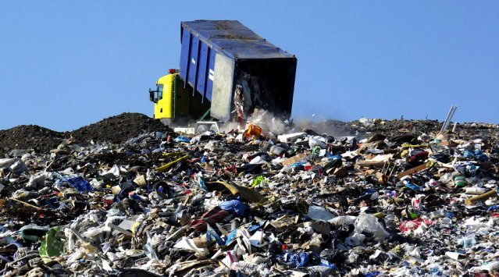
The Future: “Big Data”
More and more data is becoming available for research: is it a blessing or a curse?
Sometimes, data warehouses resemble landfills more than libraries.

Slide 40
The US Veterans Affairs experience
We have a corporate data warehouse [CDW]
About 8 million patients followed up to 15 years.
Collected from 130 individual hospitals
  Each with their own computer systems
  Some variables have been harmonized, many have not.
Example: Hemoglobin A1c
464 different tests with HbA1c in the name.
  Each center has its variables
  A new name is created when a new assay is used.
  They need to be reviewed to assure the same units are used and that they are all measuring the same thing.

Slide 41
Structured and unstructured data
Structured elements, like laboratory results and prescription fill records, are fairly easy to use.
They are generally numeric data that will require cleaning and harmonizing, but have fewer concerns.
They often need content experts to help interpretation.
Example: ICD9-CM codes for heart attacks [MI]
People admitted with a MI sometimes get discharged with “acid reflux”
They often still get coded in the emergency room with MI.
Is a code you see for MI a new event or an old one?

Slide 42
Structured and unstructured data
Unstructured elements have much promise, but need careful handling
These include doctor’s progress notes, pathology reports, imaging results.
There is a hope that this data can give information that structured data cannot.
  Family history of disease
  Lifestyle measures [exercise, diet, habits]
These are generally text notes that require informatics techniques like natural language processing to understand.

Slide 43

The Million Veteran Program
This is a Veterans Affairs project to recruit one million subjects for genetic research.
Currently 250,000 blood samples
300,000 questionnaires
To be merged with electronic medical records [EMR]

Slide 44
It takes a village….
Much emphasis is on the genotyping, but phenotyping is hard.
Phenotyping involves determining if a subject really has a disease or exposure of interest.
Misclassification of a phenotype is just as bad as misclassifying a genotype.
It takes a team of specialists to do phenotyping right.
  Informatics
  Clinicians
  Biostatisticians

Slide 45
It takes a village….
Estimation is easy, variability is hard
Use of informatics tools will always produce a result
The question is “how trustworthy is it?”.
  Is the result stable?
  Is it reproducible?
  Is it useful?
These are the questions to ask when reading about “Big Data” science.
These are the same questions you ask about all research.

Slide 46
Documentation
An issue with data mining is that we need to document what is done.
Saying “We did NLP” is unsatisfactory.
New techniques that handle big data need sufficient documentation so that others can repeat it.
Wiki-like documentation of new phenotypes makes new approaches available for other researchers.
  It fosters repeatability.
  It allows community discussions

Slide 47
New opportunities
Repeated longitudinal observations require new statistical approaches to define new phenotypes
Clustering of longitudinal trajectories
  Find subjects with similar trajectories for a risk factor over time.
  Subjects with similar trajectories may have similar risks of events in the future

Slide 48
New opportunities
Large data sets provide opportunities for more refined modeling of biological processes.
Subtle differences in models can be assessed in large data situations.
  Current work using one-compartment models to look at lag effects .

Slide 49
Concluding thoughts
Don’t fall in love with your hypotheses
Don’t fall in love with your data
Call your biostatistician early – in the design phase of your study.
Be skeptical! Ask embarrassing questions.
Thank you!

