Slide 1
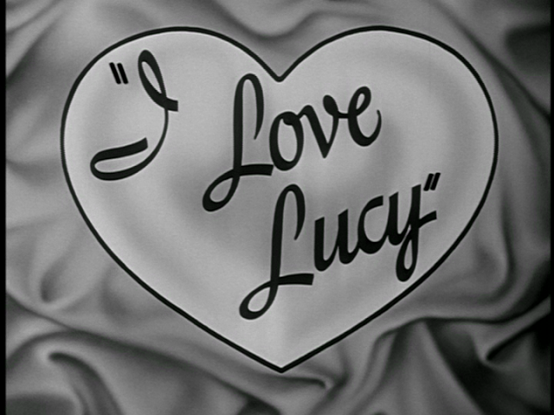
I LOVE LUCY

Slide 2
Lucy in movies

Slide 3
Al Capone

Slide 4
The St. Valentine’s Day Massacre

Slide 6
Desi Arnaz

Slide 7
Members of Desi’s Orchestra

Slide 9
Lucy making wine in Italy

Slide 10
On the way to the hospital

Slide 12
Star Trek

