Slide 1
It’s So Easy When Someone Else Does It. Using the causative “have” in the passive voice.

Slide 2
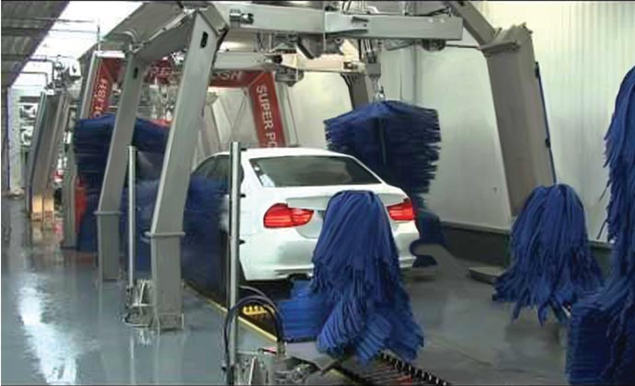
Mary loves a clean car. What did she do?

Slide 3
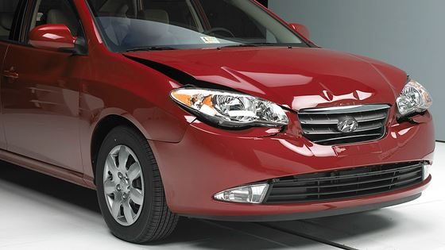
Mary got into an accident. She cannot fix this herself. What will Mary do?

Slide 4
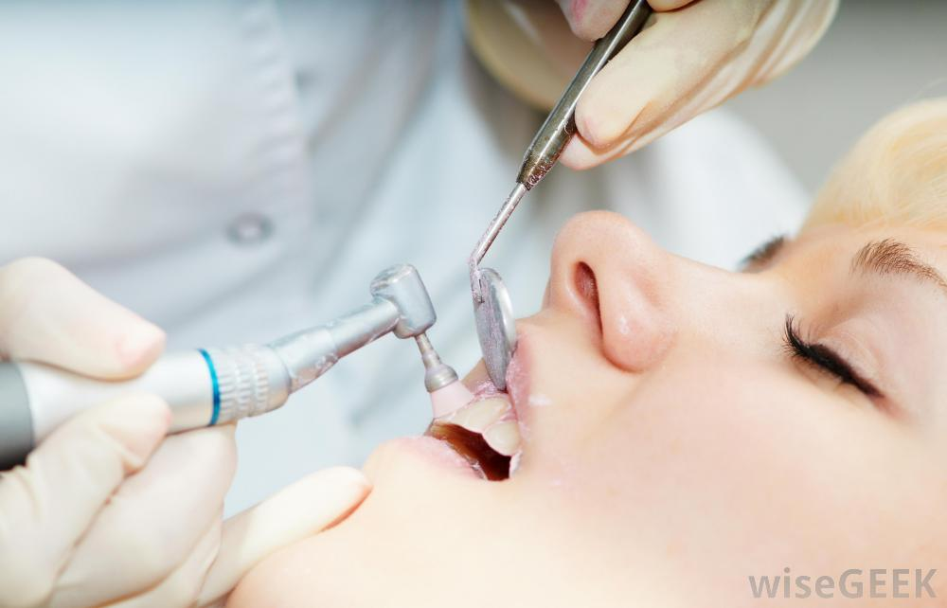
Mary is at the dentist now. Why?

Slide 5
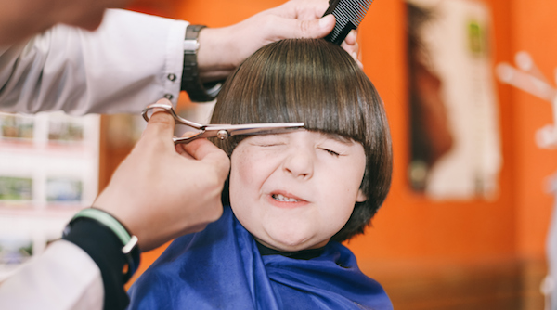
Her son’s hair was too long. What happened yesterday?

