Slide 1
Today’s Class
Error analysis
Vocabulary practice
BREAK
Mathilda’s presentation
Verb tense comparison
Discussion

Slide 2
Fat isn’t eliminated correctly /the correct way.
Energy is essential for the brain.
If I were to weigh 73 kg, … / If I weighed 73 kg
You have 100 friends on Facebook, but they aren’t really friends.
If I had done more practice, … / If I had practiced more, …
How can I get in touch with the teacher?
[Did you take the train?] No, we rented a car.
I didn’t see the “d”.

Slide 3
A,C
b. Address isn’t followed by with.
d. Address is transitive. (… the best way of addressing it)
2. C
a. I feel sympathy for the refugees.
b. Can you empathize with their problem?
d. Empathy is followed by for. (… empathy for other people’s problems)
B
a. Endeavor doesn’t collocate with needs or physical.
c. The verb endeavor is followed by the infinitive (… endeavor to do …)
d. Endeavor doesn’t mean the same as hard work.

Slide 4
4. A
b. Fulfilling is the adjective, but it doesn’t collocate with immensely.
c. Fulfillment is uncountable. (… will give me fulfillment.)
d. Fulfillment doesn’t collocate with deep.
5. D
a. Go about is followed by a gerund. (How did she go about getting …)
b. Go about is transitive. (… go about it.)
c. Go about isn’t used in the passive. ( … wrong; they just went about it the …)
6. B,D
a. I’m completely puzzled about why / as to why he has made …
c. Puzzled is not followed by with. (puzzled about the request)

Slide 5
7. A,D
b. The truth is subtly different.
c. His ability to understand the subtlety / subtleties of human
behavior makes his writing interesting.
8. A,C
b & d. Unfold can’t be followed by a noun clause.

Slide 6
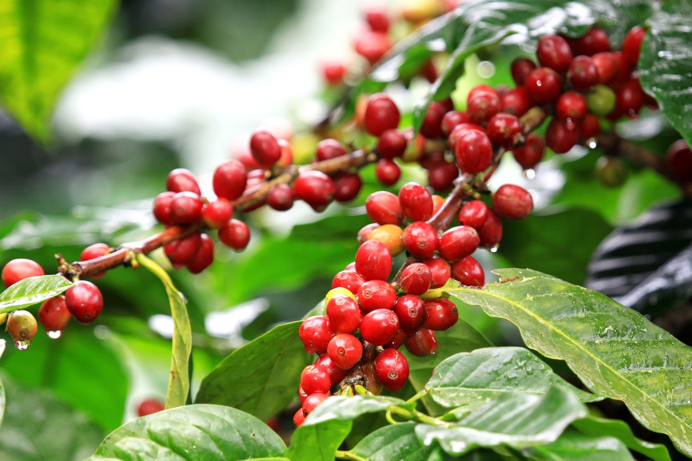
?

Slide 7
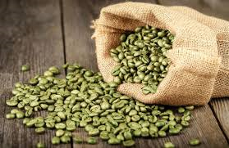
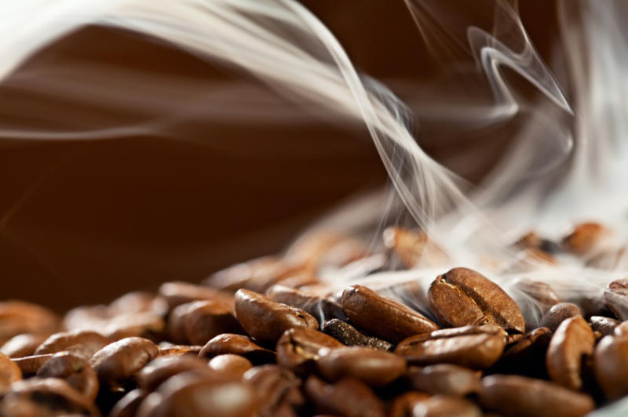
Health benefits of coffee

Slide 8
Write the correct form of these verbs in the blanks: 1. drink 2. be 3. not drink 4. consume 5. show 6. contain 7. find
In a 10-year U.S. study, people who 1______ coffee regularly 2______ less likely to die of many causes, including heart disease and diabetes, than those who 3______ coffee at all.
The more coffee study participants 4______, the lower their risk of dying, and decaf drinkers 5______ a similar pattern.
“Coffee 6______ numerous biologically active compounds, including phenolic acids, potassium, and caffeine,” said lead author Dr. Erikka Loftfield of the National Cancer Institute in Rockville, Maryland.
Many studies 7______ that coffee consumption is associated with lower risk of overall and heart-related mortality, Loftfield told Reuters Health by email.

Slide 9
In a 10-year U.S. study, people who 1 drank coffee regularly 2 were less likely to die of many causes, including heart disease and diabetes, than those who 3 didn’t drink coffee at all.
The more coffee study participants 4 consumed, the lower their risk of dying, and decaf drinkers 5 showed a similar pattern.
“Coffee 6 contains numerous biologically active compounds, including phenolic acids, potassium, and caffeine,” said lead author Dr. Erikka Loftfield of the National Cancer Institute in Rockville, Maryland.
Many studies 7 have found that coffee consumption is associated with lower risk of overall and heart-related mortality, Loftfield told Reuters Health by email.

Slide 10
QUESTIONS
1. Is there a special kind of food or drink that you like to have when you’re feeling a little down or a little ill? Why do you like to have it? For example, does it remind you of your childhood?
2. Why do you drink coffee or not drink it? How popular is coffee in your culture? If coffee is not the most popular beverage in your culture, what is? What times of the day do people drink coffee, or the most popular beverage? Do people go to special places to enjoy it? What is the atmosphere at these places like?
3. Do you think that energy drinks, like Redbull, which contain a high level of caffeine, have the same effect as several cups of coffee? Do you drink energy drinks like Redbull? Why or why not? How popular are such drinks in your culture?

