Slide 1
PO/WS 505: The 19th Amendment
Women’s Political Activism Through the Civil War

Slide 2
Agenda: Today
Finish work from last week:
Gender and socio-political roles, to 1788
The shifting landscape from the Revolution to the Jacksonian Era (1828-1850s)
A bit of context: race demographics in 19th century America
Women’s activism: Especially antislavery

Slide 3
Summary of free women’s situation
Legal situation: Coverture
property, contracts, employment, separation of husband and wife, Control over children, Protection from violence within the bonds of marriage: abuse and rape.
Socio-political:
Highly constrained communication, no appearing in public alone

Slide 4
What difference did class make for women in early America? What did it mean to be a “middle-class white woman?”

Slide 5
What changed up to the middle of the 19th century?
Increasing emphasis on “women’s sphere.”
Locking in women’s subservience to men – e.g. removing separate citizenship
But: depending on context: e.g. Eastern cities? South? Rural frontier?

Slide 6
What changed up to the middle of the 19th century? First stirrings
Some increase in education for women – women’s academies.
Women’s property acts: 1840s
Women’s involvement in religious, civic, even political life

Slide 7
We hear no longer of the alarming, and perhaps justly obnoxious din, of the ‘rights of women.’ Whatever [women’s] capacity of receiving instruction may be, there can be no use in extending it beyond the sphere of their duties.
….Historian Hannah Adams (1775-1831), written in 1832.

Slide 8
Hannah Adams, 1775-1831

Slide 9
Women, Citizenship, & Public Life in Early America

Slide 10
What did the Revolution mean, specifically, to women?

Slide 11
Gendered understanding of citizenship for women: Republican Motherhood

Slide 12
Daughters of Liberty, 1774 Woodcut

Slide 15
Nancy Hart Resisting Marauders, NC

Slide 17
A Society of Patriotic Ladies, 1775

Slide 18
Women & Elections
Citizens with “virtual representation.”
The New Jersey case
1790: “he or she”
1797: all qualified women
1807: Compromise leading to end of vote for women, African Americans.
Social realities of gender & voting: How were elections different then?

Slide 19
Understanding Voting in Early America
Rules for participating varied across colonies, states
Major limitations meant not all white men had the vote
Property/ taxpaying qualifications
Having a “stake in society”
Being free and having sufficient independence to use judgment.
Servants
Literacy
Religious qualifications

Slide 20
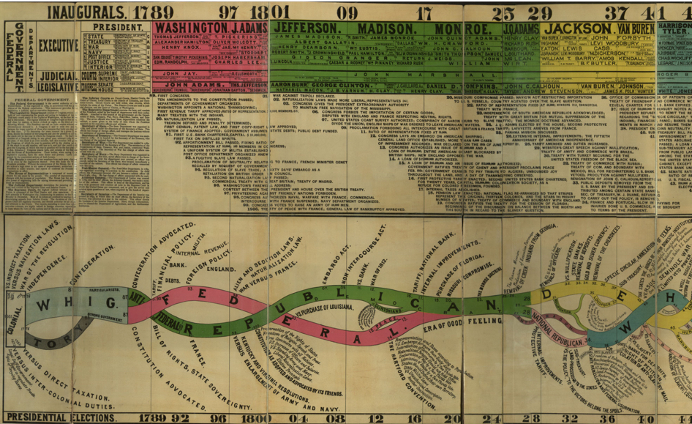

Slide 21
Public Social & Political Roles
Women’s involvement in religious, civic, even political life:
As individuals : petitioning
In groups
Benevolent societies
Clubs, sewing circles, literary assns.
Movements: evangelical religion, antislavery, temperance

Slide 22
Understanding the Demography of Race in 19th Century America

Slide 23
Discussion of Zaeske, Signatures of Citizenship: Petitioning, Antislavery, and Women’s Political Identity
What was petitioning before the antislavery movement?
Groups: Most interesting, important, curious, challenging, or counter-intuitive points or questions
At least one little thing
At least one big thing

Slide 24
Discussion of Zaeske, Signatures of Citizenship: Petitioning, Antislavery, and Women’s Political Identity
Question of recruiting: How did they get involved?
Evolution from moral to political consciousness
Practicalities: What did it take? What did they learn?
Impact on women’s citizenship, political identity.

Slide 25
Jane Dabel, The Public Roles of African American Women

Slide 26
Women and the Antislavery Movement: Looking forward to Suffrage (1)
Women encouraged and recruited by male abolition movement, especially William Lloyd Garrison, The Liberator (1830) because of the useful tasks they could do.
Women joined because of their moral outrage at the sin of slavery.
What did they do? Fundraising, sewing, organizing fairs, petitions, educating other women, literate women teaching formerly enslaved.

Slide 27
William Lloyd Garrison 1805-1879

Slide 28
Women and the Antislavery Movement: Looking forward to Suffrage (2)
The abolition movement was a social movement, not a single organization.
All parts of the abolition movement deeply unpopular, even in the North.
Women’s participation challenging and even dangerous.
Abolition itself
Women’s roles

Slide 29
Women and the Antislavery Movement: Looking forward to Suffrage (3)
Imagine the difficulties of participating effectively: communication, transportation, roles, etc.
Not as much differentiation between black/ white women’s participation as you might think.
Again: Impact on women

Slide 30
Race, Gender, and Abolitionism
Is it contradictory to find racism among white people in the abolition movement?
How much sexism was there in the abolition movement?
Do we care more about one than the other?

Slide 31
Another good book on women and abolition: Jeffrey, Julie Roy. 1998. The Great Silent Army of Abolitionism: Ordinary Women in the Antislavery Movement. Chapel Hill: University of North Carolina Press.

