Slide 1
PO/WS 505: 19th Amendment Centennial
WOMEN AND MASS-LEVEL ELECTORAL POLITICS & POWER SINCE THE 19TH AMENDMENT

Slide 2
How It Happened (cont)

Slide 3
Dawn Teele, Forging the Franchise, 2018

Slide 4
Rosalyn Terborg-Penn, African-American Women & the Struggle for the Vote, 1850-1920, 1988

Slide 5
Susan Ware, Why They Marched, Untold Stories of the Women Who Fought for the Right to Vote, 2019

Slide 6
Elaine Weiss, The Woman’s Hour: The Great Fight to Win the Vote, 2018

Slide 7
For those women who now were allowed to vote, what did they do with it? What impact did they have?

Slide 8
What Impact
Voting turnout
Interest, knowledge, awareness
Changed understanding of their citizenship
Changed culture about gender & politics
Campaign Activities
Other political engagement
How did women use their votes?
Partisanship
Vote choice

Slide 9
The Early Years: Up to WWII
Speculation about women vs actual behavior of women.
Developmental approach to understanding the impact on women’s consciousness, understanding, attitudes, behavior.
Contextual approach to understanding the impact ….

Slide 10
It is obvious from all research that there is not now and never has been anything like a homogeneous “women’s vote.”
Does this mean gender does not have an impact on women’s use of the vote?

Slide 11
Breakout Rooms

Slide 12
What do gender politics scholars mean by the “male standard” in public opinion and voting analysis? What impact does it have?
Women vote more Democratic than men.
Men vote more Republican then women

Slide 13
Breakouts
What are the most interesting/important things you learned from Wolbrecht/Corder, A Century of Votes for Women?
What remaining questions do you have?

Slide 14
Gender & Mass-Level Politics, Post WWII

Slide 15
Partisanship

Slide 16
Gender Differences in Democratic Identification Green=Women, Purple=Men

Slide 17
Republican Identification, 1952-2016 Green=Women, Purple=Men

Slide 18
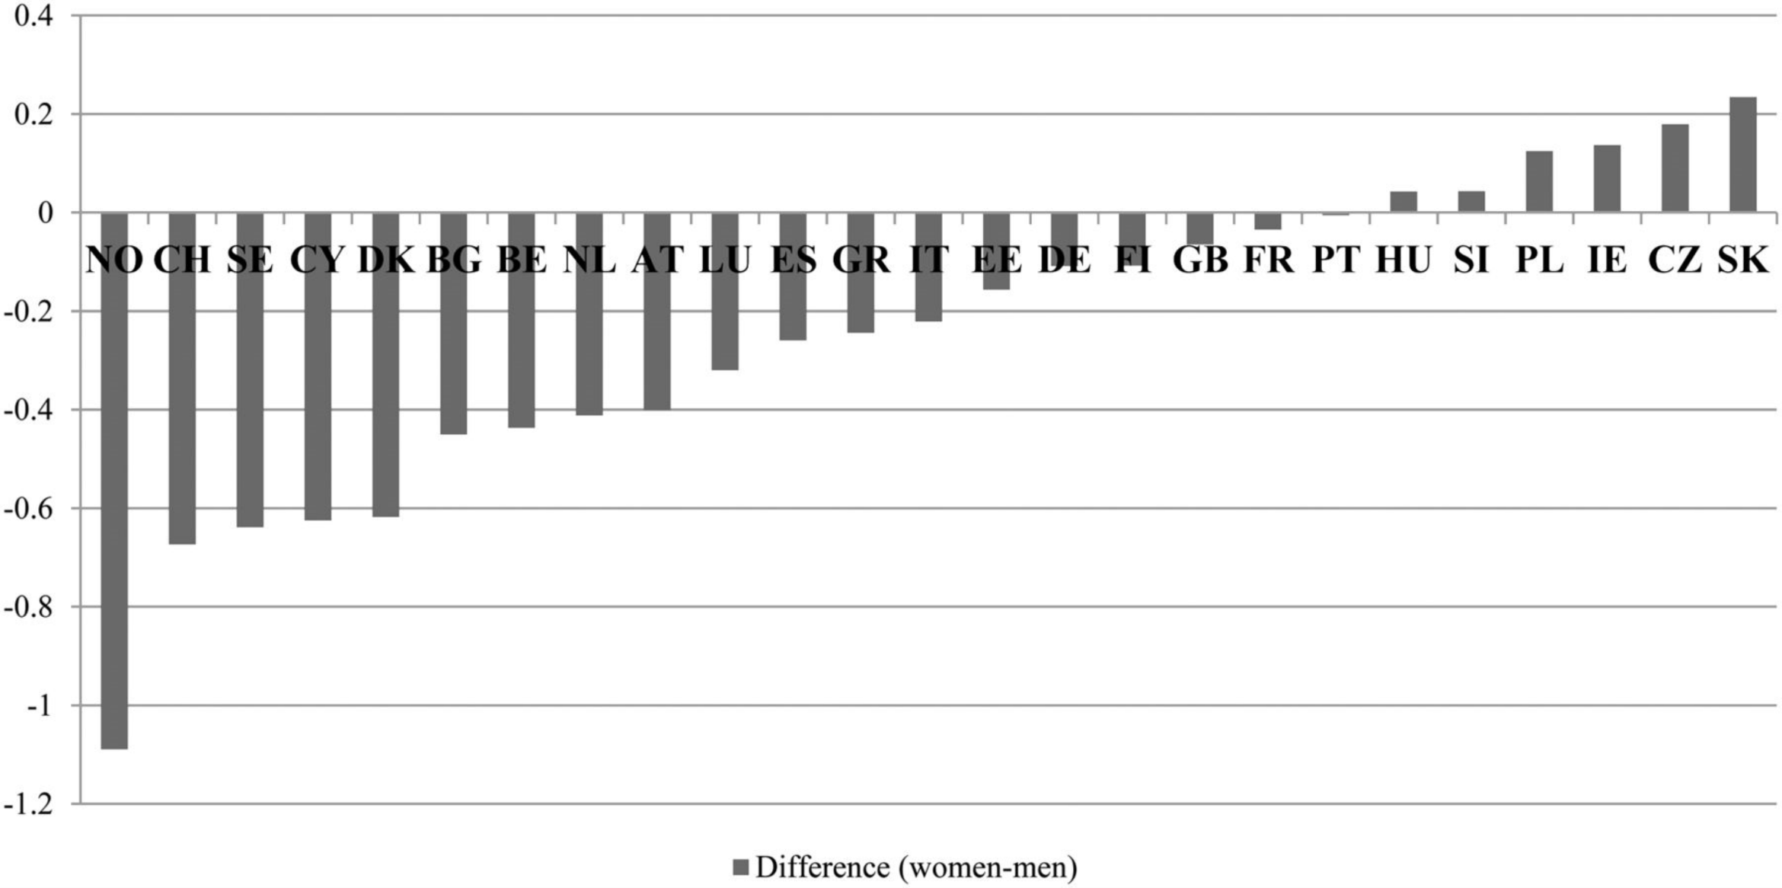
Gender Differences in Partisanship, European Union Countries, 2008
From: The Gender Gap in Voting Revisited: Women's Party Preferences in a European Context
Soc Polit. 2014;21(2):315-344. doi:10.1093/sp/jxu009
Notes:
Figure 1. Overview of the modern gender voting gap for 25 EU Member States, 2008. Source: EVS 2008, own calculations. Notes: the bars show the differences between the mean value of women minus the mean value of men on the left/right party placement scale (10 = right). A negative value indicates that women tend to prefer left-wing parties, whereas a positive value indicates that women tend to prefer right-wing parties.
18

Slide 19
Gender Differences in Clinton/Sanders Support, 2016 Primaries (from CNN Exit Polls)
STATES WHERE CLINTON WON AMONG MEN AND WOMEN
Alabama: -7
Arkansas: -16
Florida: -13
Georgia: -10
Maryland: -13
Massachusetts: -16
Mississippi: -6
North Carolina: -10
South Carolina: -11
Tennessee: -6
Texas: -9
Virginia: -13
Notes:
IN EVERY STATE WHERE CLINTON WON BOTH WOMEN’S AND MEN’S VOTES, THERE WAS NEVERTHELESS A GENDER DIFFERENCE, OFTEN SUBSTANTIAL, WHEREBY MEN WERE LESS FAVORABLE TOWARD CLINTON THAN WOMEN WERE, MORE FAVORABLE TO SANDERS THAN WOMEN WERE.

Slide 20
Gender Differences in Clinton/Sanders Support, 2016 Primaries (from CNN Exit Polls)
STATES WHERE SANDERS WON AMONG MEN AND WOMEN
New Hampshire: -12
Vermont: -8
West Virginia: -3
Wisconsin: -14
Notes:
HERE ARE STATES WHERE SANDERS WON AMONG BOTH MEN AND WOMEN. ONCE AGAIN, WE SEE GENDER DIFFERENCES WHERE MEN PREFERRED SANDERS MORE STRONGLY.

Slide 21
Gender Differences in Clinton/Sanders Support, 2016 Primaries (from CNN Exit Polls)
STATES WHERE CLINTON WON AMONG WOMEN AND SANDERS WON AMONG MEN
Connecticut: -14
Illinois: -10
Iowa: -9
Michigan: -7
Missouri: -10
Nevada: -13
Pennsylvania: -11
Ohio: -15
Oklahoma: -15
Notes:
AND HERE ARE THE STATES WHERE CLINTON WON AMONG WOMEN AND SANDERS WON AMONG MEN. AGAIN (AS YOU WOULD EXPECT) STRONG GENDER DIFFERENCES.

Slide 22
Gender Differences in Clinton/Sanders Support, 2016 Primaries (from CNN Exit Polls)
STATES WHERE CLINTON WON AMONG WOMEN AND MEN WERE DIVIDED 50-50
New York: -13
STATES WHERE WOMEN WERE DIVIDED 50-50 AND SANDERS WON AMONG MEN
Indiana: -7
STATES WHERE CLINTON WON AMONG MEN AND SANDERS WON AMONG WOMEN
Notes:
READ
SO THIS YEAR, GENDER NOT JUST BETWEEN PARTIES OR EVEN THE NEW, HUGE GAP DUE TO THE BEHAVIOR AND VIEWS OF DONALD TRUMP.

Slide 25
Results of 2016 Election if only women voted
Notes:
PRETTY EXTREME – AS NATE SILVER HAS SHOWN US ON 538.COM, HERE IS WHAT THE ELECTION WOULD LOOK LIKE AT THIS POINT IF ONLY WOMEN VOTED.

Slide 26
Results of 2016 if only men voted
Notes:
AND HERE’S WHAT IT WOULD LOOK LIKE IF ONLY MEN VOTED.
(BE CLEAR: THIS RESULT LARGELY REFLECTS WHITE MEN)
BUT SOMETHING UNUSUAL HAPPENED THIS YEAR, LIKELY RELATED TO THE FACT THAT THE LEADING DEMOCRATIC CANDIDATE IS FEMALE. HERE ARE SOME DATA FROM THE DEMOCRATIC PRIMARY SEASON;

Slide 27
2016 Election: Gender & Race

Slide 28
2016 Election: Gender & Education

Slide 29
2016 Election: Gender & Party

Slide 30
2018 Congressional Elections

Slide 31
House Vote by Gender, 2008-2018

Slide 32
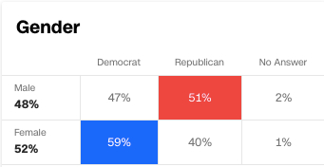
CNN Exit Polls

Slide 33
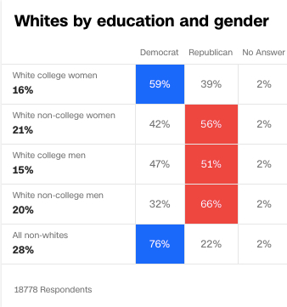
CNN Exit Polls

Slide 34
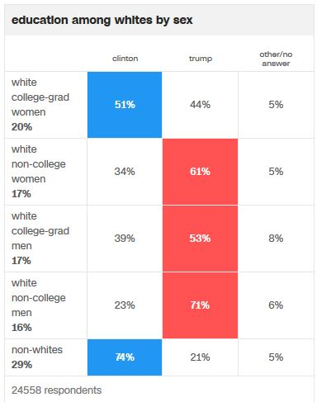
2016
2018
CNN Exit Polls

Slide 35
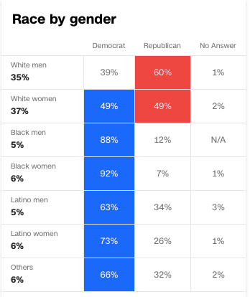
CNN Exit Polls

Slide 36
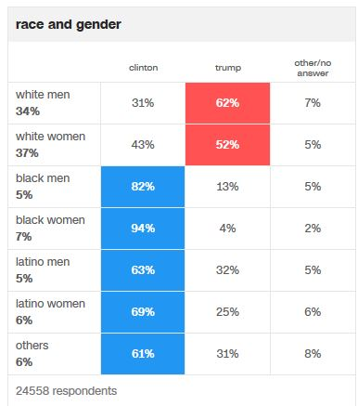
2016
2018
CNN Exit Polls

Slide 37
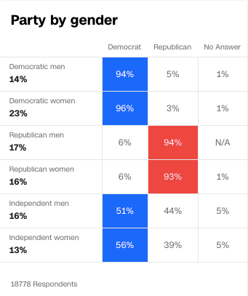
CNN Exit Polls

Slide 38
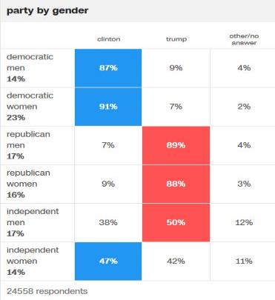
2016
2018
CNN Exit Polls

Slide 39
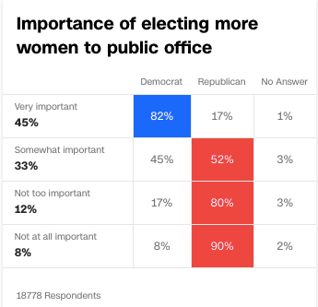
CNN Exit Polls

