Slide 1
PO/WS 505: 19th Amendment Centennial
THE CAMPAIGN FOR THE 19TH AMENDMENT

Slide 2
Last week…..

Slide 3
Hypotheses: State-Level Successes, Failures: Hypotheses
Ideology: Attitudes toward women’s rights.
Organizational capacity of women’s movements
Strength of opposition organizations

Slide 4
Hypotheses: State-Level Successes, Failures: Hypotheses
Threats of violence, disorder
Incentives, motivations of legislators
Strategic enfranchisement
Programmatic enfranchisement

Slide 5
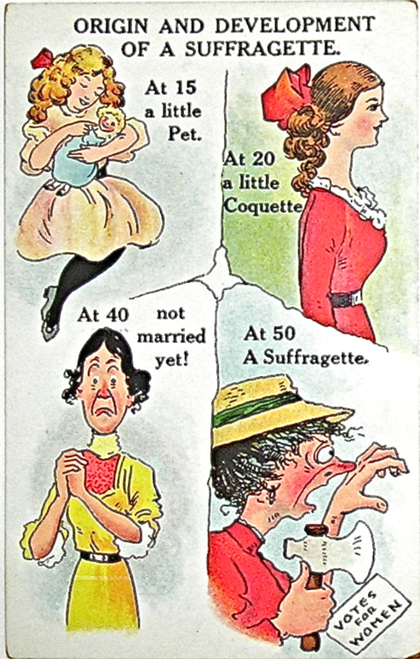

Slide 6
1914

Slide 7
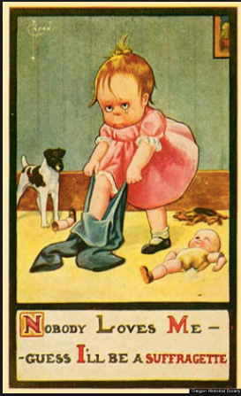

Slide 8
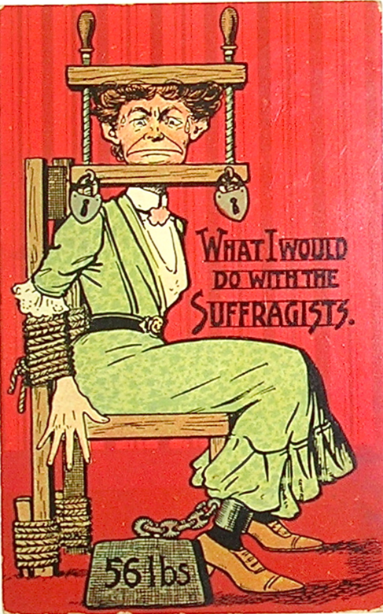

Slide 9
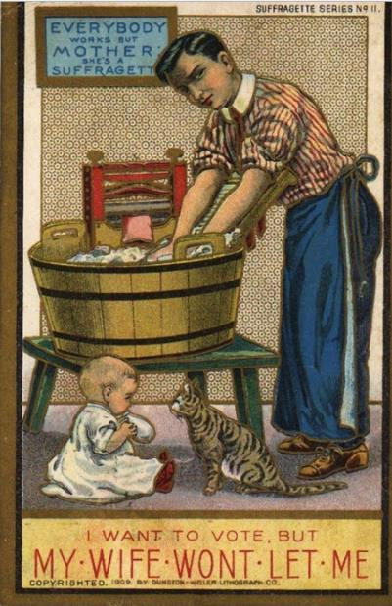

Slide 10
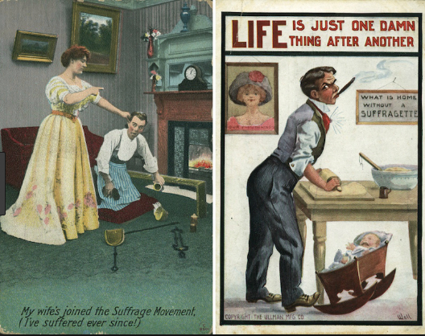

Slide 11
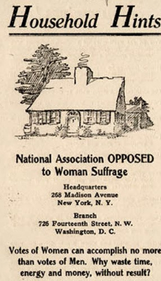

Slide 12
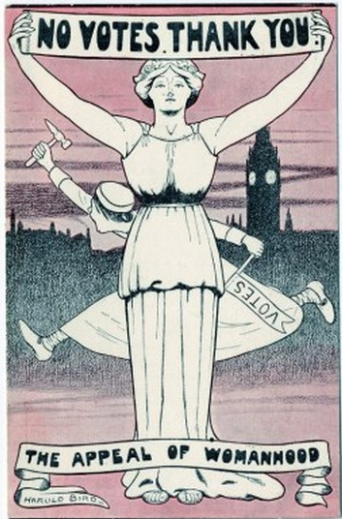

Slide 13
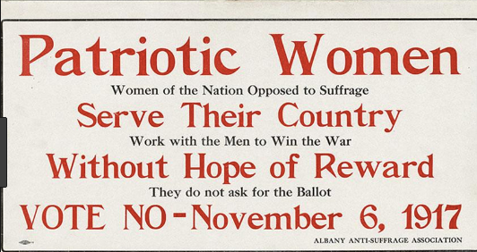

Slide 14
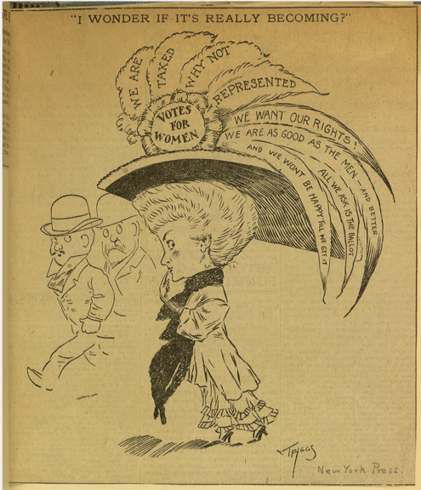

Slide 15
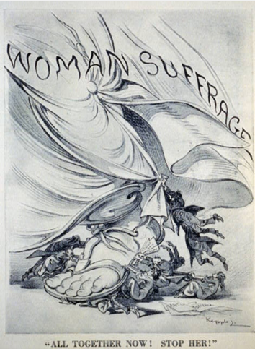
1914

Slide 16
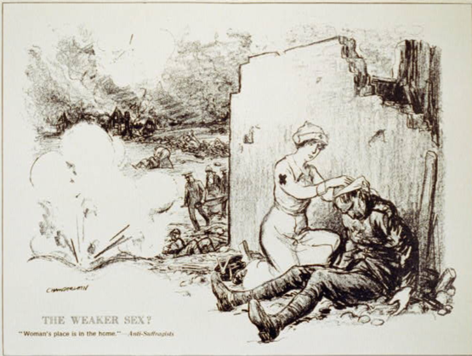
1914

Slide 17
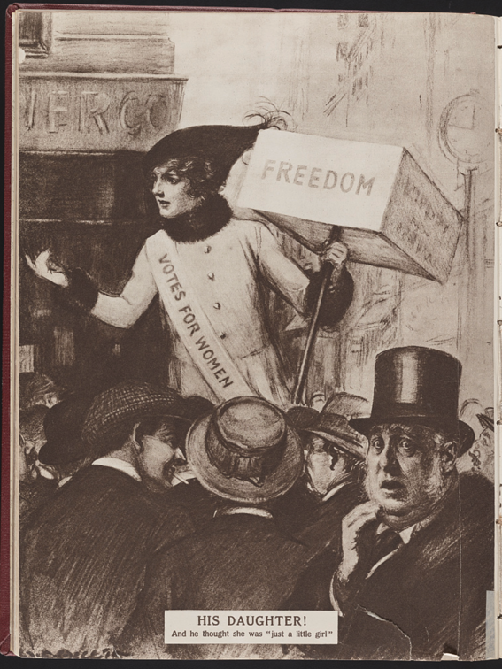
1895

Slide 18
How It Happened

Slide 19
Dawn Teele, Forging the Franchise, 2018

Slide 20
Rosalyn Terborg-Penn, African-American Women & the Struggle for the Vote, 1850-1920, 1988

Slide 21
Susan Ware, Why They Marched, Untold Stories of the Women Who Fought for the Right to Vote, 2019

Slide 22
Elaine Weiss, The Woman’s Hour: The Great Fight to Win the Vote, 2018

Slide 23
Design 3 good, fair exam questions

