Slide 1
PO/WS 505: 19th Amendment Centennial
WOMEN IN GOVERNMENT SINCE THE 19TH AMENDMENT – ELECTIVE & APPOINTED

Slide 2
Timeline of Firsts

Slide 3
Women in Congress

Slide 4
A LITTLE INTERNATIONAL CONTEXT

Slide 5
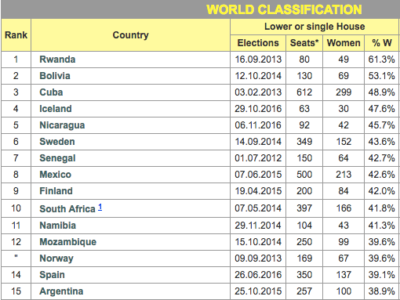

Slide 6
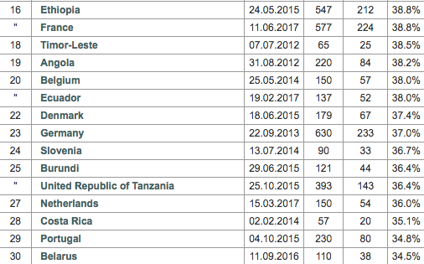

Slide 7
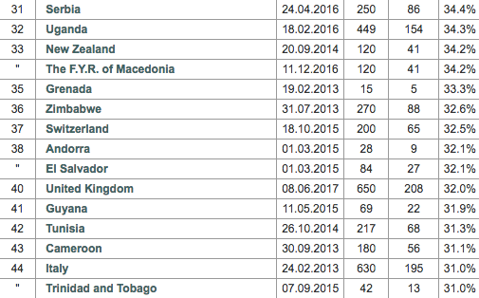

Slide 8
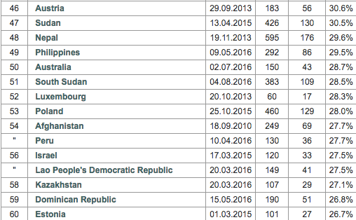

Slide 9
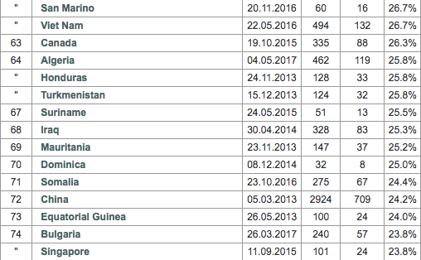

Slide 10
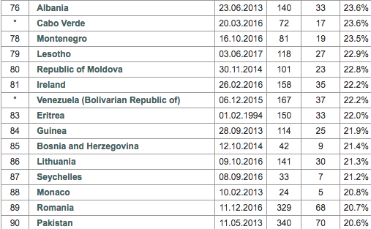
We’re #79!!!!
23.4!!

Slide 12
Elective Offices, 2019, 2020
51% of the population
22% of mayors of population >300,000
27% of the 100 largest cities
30% of members of State House/Assemblies
26% of members of State Senates
30% of Statewide executive offices other than governors, lt. governors.
35% of lieutenant governors.
18% of governors

Slide 13
Elective Offices, 2019, 2020
26% of the U.S. Senate
23% of members of the US. House of Representatives
No Vice President. Ever.
No President. Ever.

Slide 14
State Rankings: Percentage of Women State Legislators

Slide 15
State by State: Women Governors

Slide 16
State by State: Congressional Delegation

Slide 17
Women in the Federal Workforce

Slide 18
Women’s Jobs in Federal Workforce

Slide 19
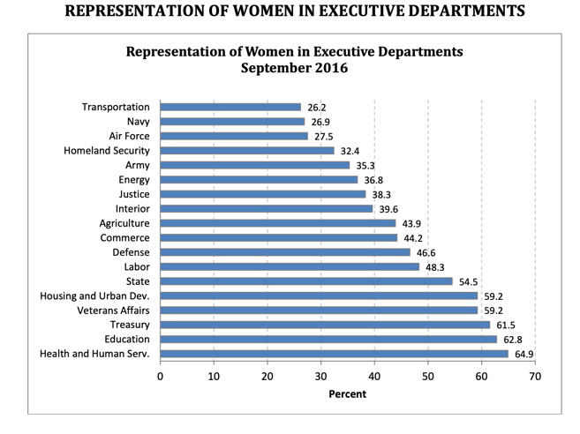

Slide 20
Why are we stuck in terms of the number of women in elective office?

Slide 21
Why does the number of women in office matter?

Slide 22
Data Sources
Partisanship, vote: American National Election Studies
Clinton/Sanders vote 2016: CNN Exit Polls
2016, 2018 votes: CNN Exit Polls
Data on women in office except federal workforce: Center for American Women in Politics
Women in national parliaments: the Inter-Parliamentary Union.
Women in the federal workforce: US Office of Personnel Management, Federal Equal Opportunity Recruitment Program, Report to Congress.

